Slide 1
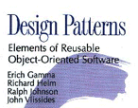
Design Patterns
Notes:
Design patterns gained popularity in computer science after the book Design Patterns: Elements of Reusable Object-Oriented Software was published in 1994 by the so-called "Gang of Four" (Gamma et al.). That same year, the first Pattern Languages of Programming Conference was held and the following year, the Portland Pattern Repository was set up for documentation of design patterns. The scope of the term remains a matter of dispute. Notable books in the design pattern genre include:
Gang of Four:-
Gamma, Erich; Richard Helm, Ralph Johnson, and John Vlissides
Design pattern sites
http://vincehuston.org/dp/

Slide 2
What is Design Patterns
If problem occurs over and over again, a solution to that problem has been used effectively .
That solution is described as pattern.
Design patterns are language independent strategies for solving common object oriented problem
Learning design patterns is good for people to communicate each other effectively.
Sun Suggest GOF(Gang of four)pioneer guys who wrote a book named “Design Pattern Element of reusable object oriented software”.

Slide 3
Existing patterns are 250 in OOPs.
But 23 design patterns by GOF are well known.
Note
Remember ,knowing concepts like abstraction,inheritence and polymorphism don’t make you object oriented designer.
We need to think about how to create flexible designs that are maintainable and that can cope with the changes.
Notes:
“Class should close for modification but should open for extension”
http://vincehuston.org/
http://www.allapplabs.com/java_design_patterns/java_design_patterns.htm

Slide 4
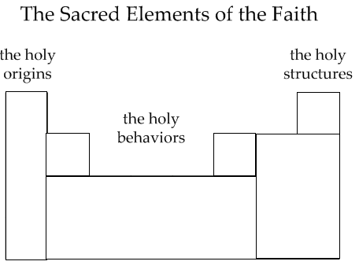
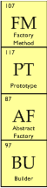
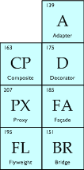
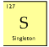
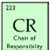
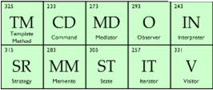
Types of Design patterns
Creational Patterns.
Structural Patterns
Behavior Pattern

Slide 5
Creational Patterns.
These patterns focus on releasing coupling between two objects while creating them.
These reduce the coupling level by ramifying the new operator from the components.
These patterns have to do with class instantiation.
Notes:
Ramifying- “to divide or spread out into branches or branchlike parts; extend Into subdivisions.”

Slide 6
Design Pattern Distribution
Creational Patterns.
Abstract factory
Factory Method
Builder
Prototype
Singleton

Slide 7
Structural Patterns
Ease the design by identifying a simple way to realize relationships between entities
These are concerned with how classes and objects are composed to form larger structure.

Slide 8
Design Pattern Distribution
Structural Patterns
Adapter
Bridge
Decorator
Façade
Flyweight
Proxy

Slide 9
Behavioral Patterns
These are concerned of algorithm and assignment of responsibilities between objects .
Identify common communication patterns between objects and realize the patterns
specifically concerned with communication between objects.

Slide 10
Design Pattern Distribution
Behavior Pattern
Command
Iterator
Chain of responsibility
Mediator
Observer
Strategy
State
Template Method
Visitor

Slide 11
Extending Object-Oriented Programming
OOP was originally introduced as programs became larger and more complex.
The idea was to wrap functionality inside objects. In other words, the inspiration was to divide and conquer. Until OOP appeared, you could divide your code into functions, but that wasn’t enough in the long run.
As programs became longer and longer, some way of dividing them up in terms of easily handled concepts was needed.
What those concepts were, depended on the program itself, and those concepts came to be known as objects.
Notes:
For example, if you take a look at what’s going on in a kitchen behind the scenes, there’s an enormous amount of complexity.
A refrigerator can contain coolant pumps, thermostats, fans, lights, and more.
A stove can contain various heating elements, timers, thermostats, lights, and more.
Considered this way, looking at every present element at once, a kitchen becomes very complex.
But if you wrap what you see up into objects, the situation is a lot easier to handle.
There’s the refrigerator. There’s the stove. That’s the dishwasher, and so on.
No problem — internal regulation and the various parts that work together are wrapped up into an easily conceptualized object.
----------------
That’s why objects are called objects in object-oriented programming — you wrap functionality up into those objects and they’re easily conceptualized,
much like refrigerators, stoves, dishwashers, and so on. Exactly what those objects are, is up to you (which is why they’re just generically called objects,
and why you’ve never heard of refrigerator-oriented programming or stoveoriented programming).
-------------------------

Slide 12
The big four OOP building blocks
There are four pillars of OOP
Abstraction
Encapsulation
Polymorphism
Inheritance.
I discuss these in the following sections.
Notes:
Abstraction is the good kind of breakdown
Abstraction is all about breaking your approach to a problem into natural segments.
This is where you come up with the objects that divide the problem into manageable parts.
In other words, abstracting a problem simply means thinking of how to tackle that problem in terms of object-oriented code.
The data items needed by each object become that object’s properties, whether public or private, and the actions each object needs to perform in the real world become its actions in code.
------------------------
Encapsulating all that junk
When you wrap methods and data up into an object, you encapsulate those methods and data. That’s the power of working with objects —
you remove the complexity from view and make it into an easily graspable object. That’s how a mass of pipes, tubing, pumps, thermostats, and lights becomes, conceptually, a refrigerator.
-----------------------------
Mighty polymorphism rangers
Another cornerstone of OOP is polymorphism: the ability to write code that can work with different object types and decide on the actual object type at runtime.
For example, you might want to write code that handles all kinds of different shapes — rectangles, circles, triangles, and so on. Although they’re different shapes, they all have in common certain actions as far as your code goes —
for example, they can all be drawn.

Slide 13
Design Patterns in Details

Slide 14
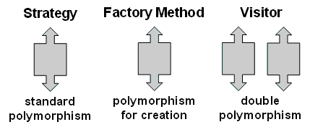
Strategy Pattern
Algorithms can be selected on the fly.
In computer programming, the strategy pattern (also known as the policy pattern) is a particular software design pattern, whereby algorithms can be selected at runtime.
The strategy pattern is useful for situations where it is necessary to dynamically swap the algorithms used in an application.
The strategy pattern is intended to provide a means to define a family of algorithms, encapsulate each one as an object, and make them interchangeable.
The strategy pattern lets the algorithms vary independently from clients that use them.

Slide 15
Strategy design pattern:
Purpose
Define a family of algorithms, encapsulate each one, and make them interchangeable.
Strategy lets the algorithm vary independently from clients that use it.
Applications
many related classes differ only in their behavior. Strategies provide a way to configure a class with one of many behaviors.
you need different variants of an algorithm. For example, you might define algorithms reflecting different space/time trade-offs. Strategies can be used when these variants are implemented as a class hierarchy of algorithms.
an algorithm uses data that clients shouldn't know about. Use the Strategy pattern to avoid exposing complex, algorithm-specific data structures.
a class defines many behaviors, and these appear as multiple conditional statements in its operations. Instead of many conditionals, move related conditional branches into their own Strategy class.
Notes:
Consequences – [the conclusion reached by a line of reasoning; inference. the effect, result, or outcome of something occurring earlier: ]
Families of related algorithms. Hierarchies of Strategy classes define a family of algorithms or behaviors for contexts to reuse. Inheritance can help factor out common functionality of the algorithms.
An alternative to subclassing. Inheritance offers another way to support a variety of algorithms or behaviors. You can subclass a Context class directly to give it different behaviors. But this hardwires the behavior into Context. It mixes the algorithm implementation with Context's, making Context harder to understand, maintain, and extend. And you can't vary the algorithm dynamically. You wind up with many related classes whose only difference is the algorithm or behavior they employ. Encapsulating the algorithm in separate Strategy classes lets you vary the algorithm independently of its context, making it easier to switch, understand, and extend.
Strategies eliminate conditional statements. The Strategy pattern offers an alternative to conditional statements for selecting desired behavior. When different behaviors are lumped into one class, it's hard to avoid using conditional statements to select the right behavior. Encapsulating the behavior in separate Strategy classes eliminates these conditional statements.
A choice of implementations. Strategies can provide different implementations of the same behavior. The client can choose among strategies with different time and space trade-offs.

Slide 16
Making Your Move with the Strategy Pattern
The Strategy design pattern says that you should extract the volatile parts of your code and encapsulate them as objects; you can use those objects as you need them.
Now you can customize your code by creating composites of objects.
At runtime, you just use polymorphism to choose the object(s) you want to work with.

Slide 17
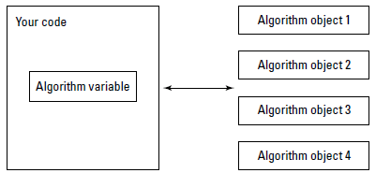
Here is the design strategy

Slide 18
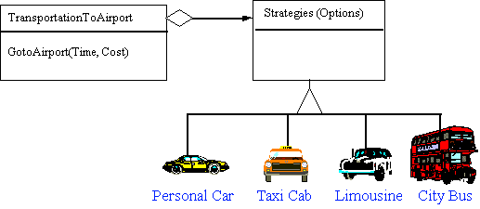
Non-Software Example for Strategy pattern
"A Strategy defines a set of algorithms that can be used interchangeably. Modes of transportation to an airport is an example of a Strategy. Several options exist such as driving one's own car, taking a taxi, an airport shuttle, a city bus, or a limousine service. For some airports, subways and helicopters are also available as a mode of transportation to the airport. Any of these modes of transportation will get a traveler to the airport, and they can be used interchangeably. The traveler must chose the Strategy based on tradeoffs between cost, convenience, and time."

Slide 19
Scenario on Strategy pattern

Slide 20
Strategy Pattern : Demo

Slide 21
“Okay,” says the CEO, “but the board of directors has already voted to
change that from ‘Now I’m flying.’ to ‘Now I’m flying at 200 mph’ next week.
And more changes will be coming later, if I know them.”
You say: maybe inheritance isn’t the answer in a case like this, where you have to spread out the handling of a changeable task over several generations of classes.
You’re going to be maintaining a lot of customized code across generations of classes when that task changes.
And as the derived classes get to be long and involved, it’s going to be tough to maintain them through all those changes.
You’re going to have to update the go method forever.

Slide 22
Handling Change with “has-a” Instead of “is-a”
Using inheritance automatically sets things up in terms of strict, inclusive “is-a” relationships, which is more likely to cause maintenance and extensibility issues down the line.
If you want to plan for change, it usually helps to think as much as you can in terms of “has-a” relationships, where your code has a number of objects whose code can be more easily updated as change happens.
When planning for change, consider “has-a” instead of “is-a” relationships, and put volatile code in the objects your application contains, rather than inheriting that code.

Slide 23
Pros :
1 Dynamic algorithm implementation
2
3
Cons:
1 Use of new operator
2 Changes require from client side
3
Soln – Factory Method.

Slide 24
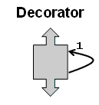
Decorator Pattern
Attach additional responsibilities or functions to an object dynamically or statically. Also known as Wrapper.
Provide an alternative to subclassing.
Add new function to an object without affecting other objects.
Make a responsibility easily added and removed dynamically.
More flexibility than static inheritance.
Transparent to the object.
The decorator pattern is an alternative to subclassing. Subclassing adds behavior at compile time whereas decorating can provide new behavior at runtime.
Notes:
Rules of thumb
Adapter provides a different interface to its subject. Proxy provides the same interface. Decorator provides an enhanced interface. [GoF, p216]Adapter changes an object's interface, Decorator enhances an object's responsibilities. Decorator is thus more transparent to the client. As a consequence, Decorator supports recursive composition, which isn't possible with pure Adapters. [GoF, p149]
Composite and Decorator have similar structure diagrams, reflecting the fact that both rely on recursive composition to organize an open-ended number of objects. [GoF, p219]
A Decorator can be viewed as a degenerate Composite with only one component. However, a Decorator adds additional responsibilities - it isn't intended for object aggregation. [GoF, p184]
Decorator is designed to let you add responsibilities to objects without subclassing. Composite's focus is not on embellishment but on representation. These intents are distinct but complementary. Consequently, Composite and Decorator are often used in concert. [GoF, p220]
Composite could use Chain of Responsibility to let components access global properties through their parent. It could also use Decorator to override these properties on parts of the composition. [GoF, p349]
Decorator and Proxy have different purposes but similar structures. Both describe how to provide a level of indirection to another object, and the implementations keep a reference to the object to which they forward requests. [GoF, p220]
Decorator lets you change the skin of an object. Strategy lets you change the guts. [GoF, p184]

Slide 25
Decorator design pattern:
Purpose
Attach additional responsibilities to an object dynamically.
Decorators provide a flexible alternative to subclassing for extending functionality.
Applications
to add responsibilities to individual objects dynamically and transparently, that
is, without affecting other objects.
for responsibilities that can be withdrawn.
when extension by subclassing is impractical. Sometimes a large number of independent extensions are possible and would produce an explosion of subclasses to support every combination. Or a class definition may be hidden or otherwise unavailable for subclassing.
Notes:
Consequences
More flexibility than static inheritance. The Decorator pattern provides a more flexible way to add responsibilities to objects than can be had with static (multiple) inheritance. With decorators responsibilities can be added and removed at run-time simply by attaching and detaching them.
Avoids feature-laden classes high up in the hierarchy. Decorator offers a pay-as-you-go approach to adding responsibilities. Instead of trying to support all foreseeable features in a complex, customizable class, you can define a simple class and add functionality incrementally with Decorator objects. Functionality can be composed from simple pieces. As a result, an application needn't pay for features it doesn't use.
A decorator and its component aren't identical. A decorator acts as a transparent enclosure. But from an object identity point of view, a decorated component is not identical to the component itself. Hence you shouldn't rely on object identity when you use decorators.
Lots of little objects. A design that uses Decorator often results in systems composed of lots of little objects that all look alike. The objects differ only in the way they are interconnected, not in their class or in the value of their variables. Although these systems are easy to customize by those who understand them, they can be hard to learn and debug.

Slide 26
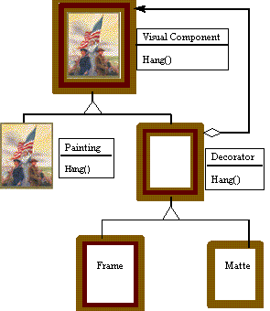
Non-software examples of Decorator patterns
The Decorator attaches additional responsibilities to an object dynamically. The ornaments that are added to pine or fir trees are examples of Decorators. Lights, garland, candy canes, glass ornaments, etc., can be added to a tree to give it a festive look. The ornaments do not change the tree itself which is recognizable as a Christmas tree regardless of particular ornaments used. As an example of additional functionality, the addition of lights allows one to "light up" a Christmas tree.
Although paintings can be hung on a wall with or without frames, frames are often added, and it is the frame which is actually hung on the wall. Prior to hanging, the paintings may be matted and framed, with the painting, matting, and frame forming a single visual component.

Slide 27
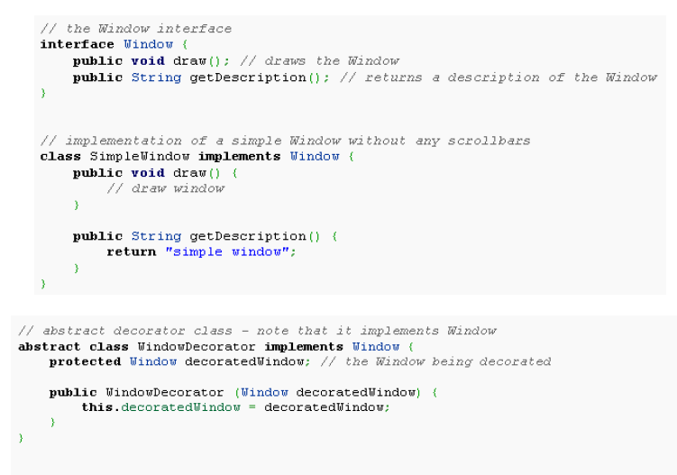
Scenario on Decorator Pattern

Slide 28
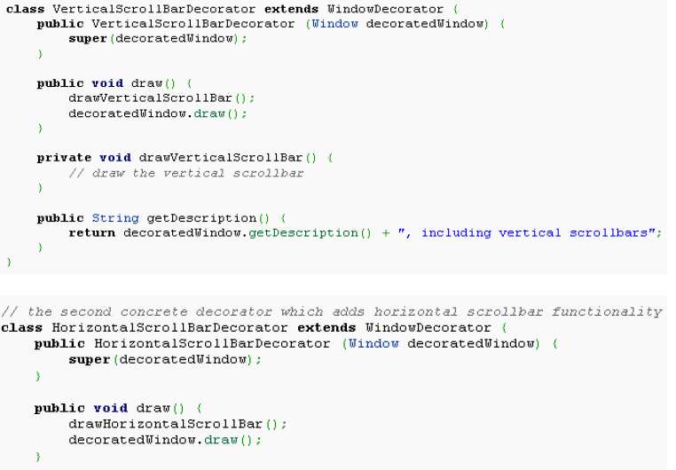

Slide 29
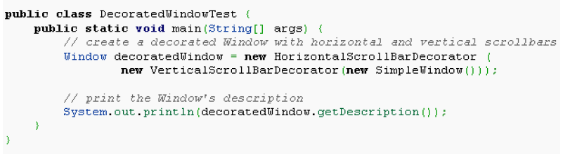
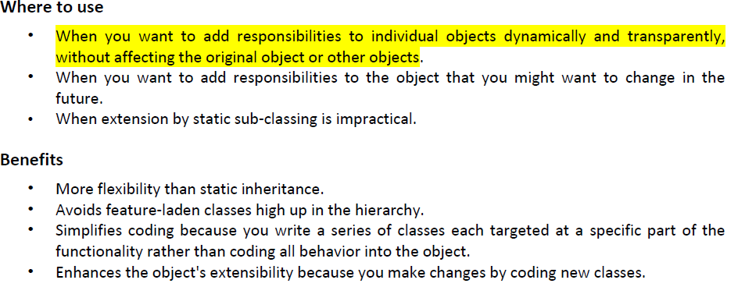

Slide 30
Decorator Pattern : Demo

Slide 31
Scenario
You’re on the job as the new Design Pattern consultant at GigantoComputer company, getting paid an exorbitant amount of money, and you’re in the company cafeteria.
“What’ll you have?” asks the surly cook behind the grill counter.
“A burger,” you say, wrestling with your tray.
The cook rings it up on the cash register, and then remembers to ask, “Fries
with that?”
“Sure,” you say.
The cook clears the order on the cash register and starts over, saying,
“Burger and fries,” and enters that.
“Let’s make that a cheeseburger,” you say on impulse.
The cook gives you a dirty look and starts the order over from scratch, pecking
at the keyboard and saying, “Burger with cheese and fries. Okay. That it?”
“Hmm,” you say, scanning the posted menu. “Maybe make that a bacon
cheeseburger.”
The cook stares at you and seems on the verge of saying something unpleasant,
but enters the order into the cash register, starting the whole process
over.

Slide 32
Here’s an example that makes keeping your core code closed for modification
more clear. Say that the company you’re working for as a consultant, GigantoComputer, decides to make a new computer. Here’s the code for the Computer class:
public class Computer
{
public Computer()
{
}
public String description()
{
return “You’re getting a computer.”;
}
}

Slide 33
“We can just change the code this way”:
public class Computer
{
public Computer()
{
}
public String description()
{
return “You’re getting a computer and a disk.”;
}
}

Slide 34
But some customers are never satisfied — they want a monitor too. So the
company programmers change the code again to this:
public class Computer
{
public Computer()
{
}
public String description()
{
return “You’re getting a computer and a disk and a monitor.”;
}
}

Slide 35
Factory Method Pattern
The essence of the Factory Pattern is to "Define an interface for creating an object, but let the subclasses decide which class to instantiate. The Factory method lets a class defer instantiation to subclasses.“
It creates the object for the client and returns ,but implementation details will be hidden to the user.
How do you “let the subclasses decide which class to instantiate” when creating an object factory?
The way to do that is to define your factory as an abstract class or interface that has to be implemented by the subclasses that actually do the work by creating objects.
Notes:
Rules of thumb
Abstract Factory classes are often implemented with Factory Methods, but they can be implemented using Prototype. [GoF, p95]
Factory Methods are usually called within Template Methods. [GoF, p116]
Factory Method: creation through inheritance. Prototype: creation through delegation.
Often, designs start out using Factory Method (less complicated, more customizable, subclasses proliferate) and evolve toward Abstract Factory, Prototype, or Builder (more flexible, more complex) as the designer discovers where more flexibility is needed. [GoF, p136]
Prototype doesn't require subclassing, but it does require an Initialize operation. Factory Method requires subclassing, but doesn't require Initialize. [GoF, p116]
The advantage of a Factory Method is that it can return the same instance multiple times, or can return a subclass rather than an object of that exact type. [Davis, p4]
Some Factory Method advocates recommend that as a matter of language design (or failing that, as a matter of style) absolutely all constructors should be private or protected. It's no one else's business whether a class manufactures a new object or recycles an old one. [Davis, p5]
The new operator considered harmful. There is a difference between requesting an object and creating one. The new operator always creates an object, and fails to encapsulate object creation. A Factory Method enforces that encapsulation, and allows an object to be requested without inextricable coupling to the act of creation. [Amsterdam, p19]

Slide 36
Factory Method design pattern:
Purpose
Define an interface for creating an object, but let subclasses decide which class to instantiate.
Factory Method lets a class defer instantiation to subclasses.
Applications
a class can't anticipate the class of objects it must create.
a class wants its subclasses to specify the objects it creates.
classes delegate responsibility to one of several helper subclasses, and you want
to localize the knowledge of which helper subclass is the delegate.
Notes:
Consequences
Provides hooks for subclasses. Creating objects inside a class with a factory method is always more flexible than creating an object directly. Factory Method gives subclasses a hook for providing an extended version of an object.
Connects parallel class hierarchies. In the examples we've considered so far, the factory method is only called by Creators. But this doesn't have to be the case; clients can find factory methods useful, especially in the case of parallel class hierarchies.

Slide 37
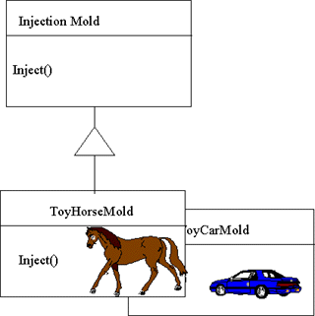
Non-software examples of Factory Method Pattern
The Factory Method defines an interface for creating objects, but lets subclasses decide which classes to instantiate. Injection molding presses demonstrate this pattern. Manufacturers of plastic toys process plastic molding powder, and inject the plastic into molds of the desired shapes. The class of toy (car, action figure, etc.) is determined by the mold.

Slide 38
Scenario on Factory Method Pattern
Let’s suppose an application asks for entering the name and sex of a person. If the sex is Male (M), it displays welcome message saying Hello Mr. <Name> and if the sex is Female (F), it displays message saying Hello Ms <Name>.
Notes:
Factory of what? Of classes. In simple words, if we have a super class and n sub-classes, and based on data provided, we have to return the object of one of the sub-classes, we use a factory pattern.

Slide 39
Advantages of factory pattern
The creation of an object precludes its reuse without significant duplication of code.
The creation of an object requires access to information or resources that should not be contained within the composing class.
The lifetime management of the generated objects must be centralized to ensure a consistent behavior within the application.

Slide 40
Final notes
Factory pattern is most suitable where there is some complex object creation steps are involved.
To ensure that these steps are centralized and not exposed to composing classes, factory pattern should be used.
We can see many examples of factory pattern in JDK itself e.g.
java.sql.DriverManager#getConnection()
java.net.URL#openConnection()
java.lang.Class#newInstance()
java.lang.Class#forName()

Slide 41
Implementation Issues
Creator can be abstract or concrete
Should the factory method be able to create multiple kinds of products?
If so, then the factory method has a parameter (possibly used in an if-else!) to decide what object to create.

Slide 42
Factory Method Pattern : Demo

Slide 43
Scenario
The big boss comes into your office and says, “Someone’s been editing the
data in our central database — why wasn’t I informed?”
“How’s that?” you ask. “You want to be informed of every edit that happens to
the data?” You know the boss is new on the job, but this is something even
more clueless than you’d expected.
“That’s right,” the boss says. “I want personal notification each time a record
is changed in the database. I want to keep an eye on what goes on around here.”
“You mean, like a memo?”
“Right.”
“Hmm,” you say. “I think I have a better idea. How about I use the …..
design pattern and register you as a database …..??”
“Huh?” the boss asks.
“You’ll be notified each time the database is modified,” you say. “No memos
needed. It’ll all be done automatically, in code.”
“That’s all I ask,” the boss says, leaving.

Slide 44
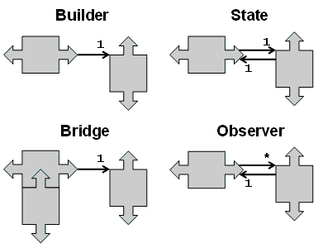
Observer Pattern
The observer pattern (a subset of the asynchronous publish/subscribe pattern) is a software design pattern in which an object, called the subject, maintains a list of its dependents, called observers, and notifies them automatically of any state changes, usually by calling one of their methods.
It is mainly used to implement distributed event handling systems.
The "model" broadcasts to many possible "views", and each "view" can dialog with the "model"

Slide 45
Observer design pattern:
Purpose
Define a one-to-many dependency between objects so that when one object changes state, all its dependents are notified and updated automatically.
Applications
When an abstraction has two aspects, one dependent on the other. Encapsulating these aspects in separate objects lets you vary and reuse them independently.
When a change to one object requires changing others, and you don't know how many objects need to be changed.
When an object should be able to notify other objects without making assumptions about who these objects are. In other words, you don't want these objects tightly coupled.
Notes:
Consequences
Abstract coupling between Subject and Observer. All a subject knows is that it has a list of observers, each conforming to the simple interface of the abstract Observer class. The subject doesn't know the concrete class of any observer. Thus the coupling between subjects and observers is abstract and minimal. Because Subject and Observer aren't tightly coupled, they can belong to different layers of abstraction in a system. A lower-level subject can communicate and inform a higher-level observer, thereby keeping the system's layering intact. If Subject and Observer are lumped together, then the resulting object must either span two layers (and violate the layering), or it must be forced to live in one layer or the other (which might compromise the layering abstraction).
Support for broadcast communication. Unlike an ordinary request, the notification that a subject sends needn't specify its receiver. The notification is broadcast automatically to all interested objects that subscribed to it. The subject doesn't care how many interested objects exist; its only responsibility is to notify its observers. This gives you the freedom to add and remove observers at any time. It's up to the observer to handle or ignore a notification.

Slide 46
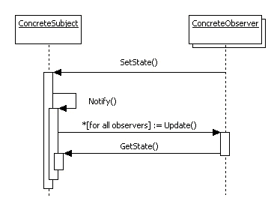
Interaction
ConcreteSubject notifies its observers whenever a change occurs that could make its observers' state inconsistent with its own.
After being informed of a change in the concrete subject, a ConcreteObserver object may query the subject for information.
ConcreteObserver uses this information to reconcile its state with that of the subject.

Slide 47
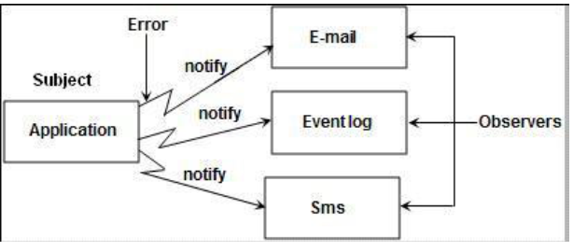

Slide 48
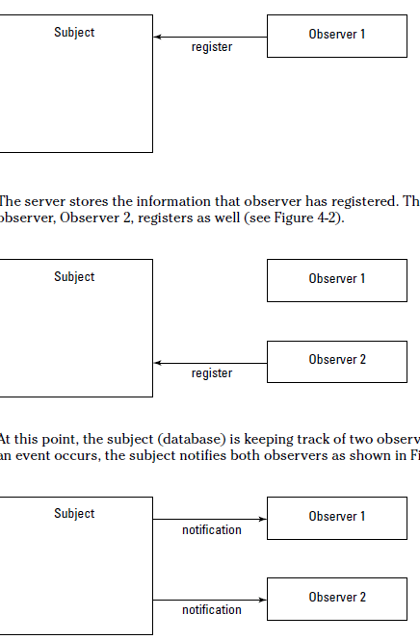

Slide 49
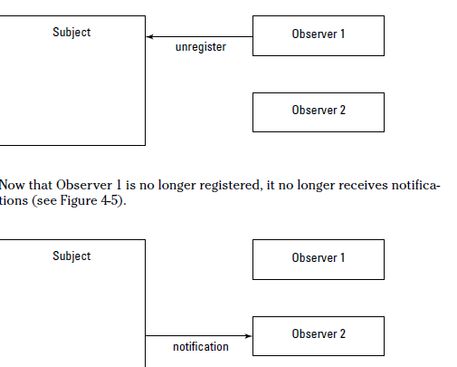

Slide 50
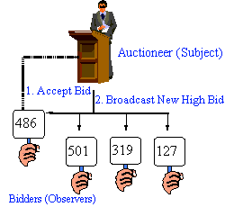
Non-software examples of Observer design patterns
The Observer defines a one-to-many relationship so that when one object changes state, the others are notified and updated automatically. Some auctions demonstrate this pattern. Each bidder possesses a numbered paddle that is used to indicate a bid. The auctioneer starts the bidding, and "observes" when a paddle is raised to accept the bid. The acceptance of the bid changes the bid price which is broadcast to all of the bidders in the form of a new bid.
Notes:
Check list
Differentiate between the core (or independent) functionality and the optional (or dependent) functionality.
Model the independent functionality with a "subject" abstraction.
Model the dependent functionality with an "observer" hierarchy.
The Subject is coupled only to the Observer base class.
The client configures the number and type of Observers.
Observers register themselves with the Subject.
The Subject broadcasts events to all registered Observers.
The Subject may "push" information at the Observers, or, the Observers may "pull" the information they need from the Subject.
-------------------------
Rules of thumb
Chain of Responsibility, Command, Mediator, and Observer, address how you can decouple senders and receivers, but with different trade-offs. Chain of Responsibility passes a sender request along a chain of potential receivers. Command normally specifies a sender-receiver connection with a subclass. Mediator has senders and receivers reference each other indirectly. Observer defines a very decoupled interface that allows for multiple receivers to be configured at run-time. [GoF, p347]Mediator and Observer are competing patterns. The difference between them is that Observer distributes communication by introducing "observer" and "subject" objects, whereas a Mediator object encapsulates the communication between other objects. We've found it easier to make reusable Observers and Subjects than to make reusable Mediators. [GoF, p346]
On the other hand, Mediator can leverage Observer for dynamically registering colleagues and communicating with them. [GoF, p282]

Slide 51
Scenario on Observer Pattern

Slide 52
Observer Pattern : Demo

Slide 53
Scenario
The big boss comes into your office and says, “Someone’s been editing the
data in our central database — why wasn’t I informed?”
“How’s that?” you ask. “You want to be informed of every edit that happens to
the data?” You know the boss is new on the job, but this is something even
more clueless than you’d expected.
“That’s right,” the boss says. “I want personal notification each time a record
is changed in the database. I want to keep an eye on what goes on around here.”
“You mean, like a memo?”
“Right.”
“Hmm,” you say. “I think I have a better idea. How about I use the Observer
design pattern and register you as a database observer?”
“Huh?” the boss asks.
“You’ll be notified each time the database is modified,” you say. “No memos
needed. It’ll all be done automatically, in code.”
“That’s all I ask,” the boss says, leaving.

Slide 54
Notifying Observers with the Observer Pattern

Slide 55
At any time, an observer, such as Observer 1, can unregister (ask to stop receiving notifications — for example, it may be shutting down) with the subject, as shown in Figure

Slide 56
Creating a subject
The subject has to let observers register and has to notify them when an event occurs.
According to the Subject interface, the three methods a subject has to implement in these examples are: registerObserver,
removeObserver, and notifyObservers.
That’s what does in this example.

Slide 57
Subject
import java.util.*;
public class Database implements Subject
{
private Vector<Observer> observers;
public Database()
{
observers = new Vector<Observer>();
}
public void registerObserver(Observer o)
{
observers.add(o);
}
public void removeObserver(Observer o)
{
observers.remove(o);
}

Slide 58
Here’s what the editRecord method looks like: When this method is called,
you pass it the database operation you want to perform and the record you want to work on, both as strings in this example.
Those strings are stored so they can be passed on to the observers. After the strings are stored, the notifyObservers method, coming up next, is called to notify all observers

Slide 59
import java.util.*;
public class Database implements Subject
{
private Vector<Observer> observers;
private String operation;
private String record;
.
.
.
public void notifyObservers()
{
for (int loopIndex = 0; loopIndex < observers.size(); loopIndex++) {
Observer observer = (Observer)observers.get(loopIndex);
observer.update(operation, record);
}
}
public void editRecord(String operation, String record)
{
this.operation = operation;
this.record = record;
notifyObservers();
}
}

Slide 60
Creating observers
To create an observer, you just have to implement the Observer interface you’ve created, which has only one method, update.
Here’s what creating an observer for the archives, which I’ll call the
Archiver class, looks like:
public class Archiver implements Observer
{
public Archiver()
{
}
public void update(String operation, String record)
{
System.out.println(“The archiver says a “ + operation +
“ operation was performed on “ + record);
}
}

Slide 61
Testing the Database observers
public class TestObserver
{
public static void main(String args[])
{
Database database = new Database();
Archiver archiver = new Archiver();
Client client = new Client();
Boss boss = new Boss();
database.registerObserver(archiver);
database.registerObserver(client);
database.registerObserver(boss);
database.editRecord(“delete”, “record 1”);}
}

Slide 62
Excellent. All the observers were notified, which is just what you want. That’s an implementation of the Observer design pattern.
It’s more flexible than hard coding everything into one unbreakable block and allows you to add or remove observers at runtime.
It couples your objects loosely, which is something you should strive for, and builds composite objects using “has-a” relationships.

Slide 63
Using Java’s Observer Interface and Observable Class
Java already comes with some built-in support for creating observer-based code, but, as you’re going to see, it’s not as flexible as the code discussed earlier in this phase.
Java’s support here is based on the Observer interface and the Observable class.

Slide 64
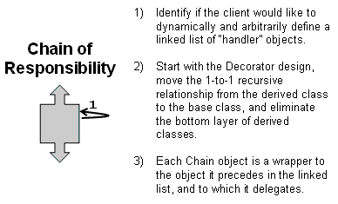
Chain of Responsibility Pattern
In Object Oriented Design, the chain-of-responsibility pattern is a design pattern consisting of a source of command objects and a series of processing objects.
Each processing object contains a set of logic that describes the types of command objects that it can handle, and how to pass off those that it cannot to the next processing object in the chain.
A mechanism also exists for adding new processing objects to the end of this chain.
This pattern promotes the idea of loose coupling, which is considered a programming best practice.
Notes:
define "linked list" functionality in the base class and implement "domain" functionality in derived classes

Slide 65
Chain of Responsibility design pattern:
Purpose
Avoid coupling the sender of a request to its receiver by giving more than one object a chance to handle the request.
Chain the receiving objects and pass the request along the chain until an object handles it
Applications
more than one object may handle a request, and the handler isn't known a priori. The handler should be ascertained automatically.
you want to issue a request to one of several objects without specifying the receiver explicitly.
the set of objects that can handle a request should be specified dynamically.
Notes:
Consequences
Reduced coupling. The pattern frees an object from knowing which other object handles a request. An object only has to know that a request will be handled "appropriately." Both the receiver and the sender have no explicit knowledge of each other, and an object in the chain doesn't have to know about the chain's structure.
Added flexibility in assigning responsibilities to objects. Chain of Responsibility gives you added flexibility in distributing responsibilities among objects. You can add or change responsibilities for handling a request by adding to or otherwise changing the chain at run-time. You can combine this with subclassing to specialize handlers statically.
Receipt isn't guaranteed. Since a request has no explicit receiver, there's no guarantee it'll be handled—the request can fall off the end of the chain without ever being handled. A request can also go unhandled when the chain is not configured properly.

Slide 66
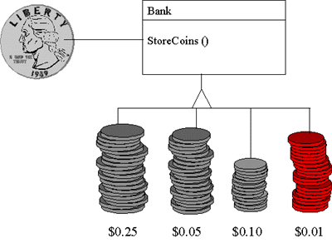
Non-software examples of Chain of Responsibility Pattern
The Chain of Responsibility pattern avoids coupling the sender of a request to the receiver by giving more than one object a chance to handle the request. Mechanical coin sorting banks use the Chain of Responsibility. Rather than having a separate slot for each coin denomination coupled with a receptacle for the denomination, a single slot is used. When the coin is dropped, the coin is routed to the appropriate receptacle by the mechanical mechanisms within the bank.
Notes:
Check list
The base class maintains a "next" pointer.
Each derived class implements its contribution for handling the request.
If the request needs to be "passed on", then the derived class "calls back" to the base class, which delegates to the "next" pointer.
The client (or some third party) creates and links the chain (which may include a link from the last node to the root node).
The client "launches and leaves" each request with the root of the chain.
Recursive delegation produces the illusion of magic.
Rules of thumb
Chain of Responsibility, Command, Mediator, and Observer, address how you can decouple senders and receivers, but with different trade-offs. Chain of Responsibility passes a sender request along a chain of potential receivers.Chain of Responsibility can use Command to represent requests as objects. [GoF, p349]
Chain of Responsibility is often applied in conjunction with Composite. There, a component's parent can act as its successor. [GoF, p232]

Slide 67
Scenario on Chain of Responsibility Pattern
The responsibility of handling the request data is given to any of the members of the “chain”. If the first link of the chain cannot handle the responsibility, it passes the request data to the next level in the chain, i.e. to the next link. For readers, familiar with concepts of Java, this is similar to what happens in an Exception Hierarchy. Suppose the code written throws an ArrayIndexOutOfBoundsException. Now, this exception is because of some bug in coding and so, it gets caught at the correct level. Suppose, we have an application specific exception in the catch block. This will not be caught by that. It will find for an Exception class and will be caught by that as both the application specific exceptions and the ArrayIndexOutOfBoundsException are sub-classes of the class Exception. Once get caught by the exception, which is the base class, it will then not look for any other exception. This is precisely the reason why, we get an “Exception is unreachable” message when we try to add a catch block with the exception below the parent exception catch block. So, in short, the request rises in hierarchy till some object takes responsibility to handle this request.

Slide 68
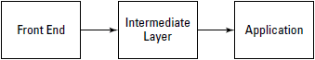
Creating chainable objects
There are three application layers that can deal with a help request in this
example — the front end, the intermediate layer, and the application object —
and you want to chain those objects together as shown in Figure

Slide 69
The Chain-of-responsibility pattern lets more than one object handle a request without mutual knowledge. We avoid coupling between the sender of a request and the possible receivers.
We place all receivers in a chain which lets the receiving objects pass the request along to the next receiver in the chain until one receiver handles it, or the end of the chain is reached.
The Chain of Responsibility pattern allows a number of classes to attempt to handle a request, without any of them knowing about the capabilities of the other classes.
It provides a loose coupling between these classes; the only common link is the request that is passed between them. The request is passed along until one of the classes can handle it.

Slide 70
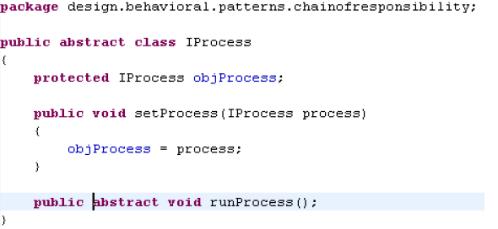

Slide 71
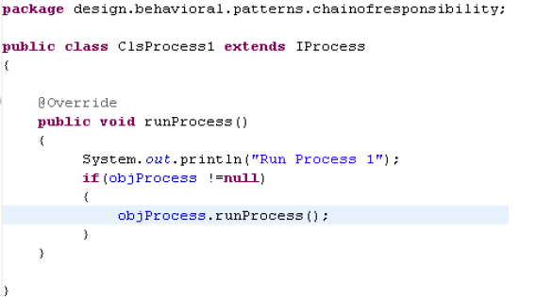
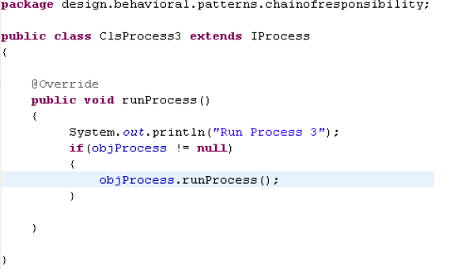
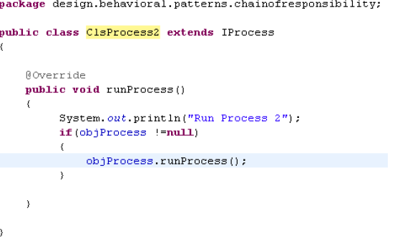

Slide 72
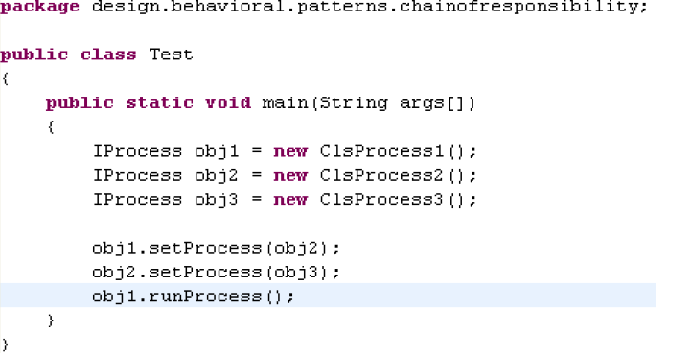

Slide 73
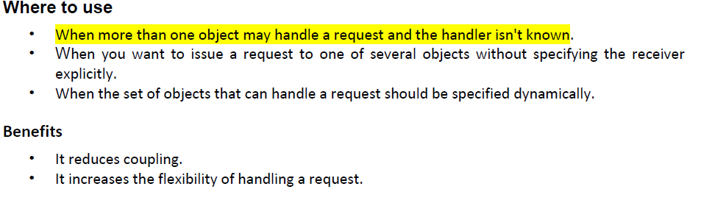

Slide 74
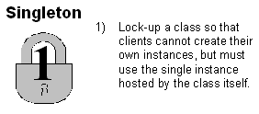
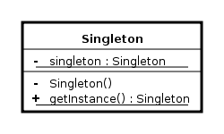
Singleton Patterns
In software engineering, the singleton pattern is a design pattern that is used to restrict instantiation of a class to one object.
This is useful when exactly one object is needed to coordinate actions across the system.
Sometimes it is generalized to systems that operate more efficiently when only one or a few objects exist.
Notes:
Check list
Define a private static attribute in the "single instance" class.
Define a public static accessor function in the class.
Do "lazy initialization" (creation on first use) in the accessor function.
Define all constructors to be protected or private.
Clients may only use the accessor function to manipulate the Singleton.
----------------
Rules of thumb
Abstract Factory, Builder, and Prototype can use Singleton in their implementation. [GoF, p134]Facade objects are often Singletons because only one Facade object is required. [GoF, p193]
State objects are often Singletons. [GoF, p313]
It's relatively easy to protect Singleton against multiple instantiations because there is good language support in this area. The most complicated problem is managing a Singleton's lifetime, especially its destruction ... There are serious threading issues surrounding the pattern. [Alexandrescu, p155] For C++ lifetime issues, see Alexandrescu, pp133-145. For C++ multi-threaded implementation, see Alexandrescu, pp145-148. For Java multi-threaded implementation, see Freeman, pp179-182. For subclassing the Singleton instance, see Gamma, pp130-131.
The advantage of Singleton over global variables is that you are absolutely sure of the number of instances when you use Singleton, and, you can change your mind and manage any number of instances. [Ralph Johnson]
The Singleton design pattern is one of the most inappropriately used patterns. Singletons are intended to be used when a class must have exactly one instance, no more, no less ... [Designers] frequently use Singletons in a misguided attempt to replace global variables ... A Singleton is, for intents and purposes, a global variable. The Singleton does not do away with the global; it merely renames it. [Hyslop, p51]
When is Singleton unnecessary? Short answer: most of the time. Long answer: when it's simpler to pass an object resource as a reference to the objects that need it, rather than letting objects access the resource globally ... The real problem with Singletons is that they give you such a good excuse not to think carefully about the appropriate visibility of an object. Finding the right balance of exposure and protection for an object is critical for maintaining flexibility. [Kerievsky, pp115-116]
Our group had a bad habit of using global data, so I did a study group on Singleton. The next thing I know Singletons appeared everywhere and none of the problems related to global data went away. The answer to the global data question is not, "Make it a Singleton." The answer is, "Why in the hell are you using global data?" Changing the name doesn't change the problem. In fact, it may make it worse because it gives you the opportunity to say, "Well I'm not doing that, I'm doing this” – even though this and that are the same thing. [Frieder Knauss]

Slide 75
Singleton design pattern:
Purpose
Ensure a class only has one instance, and provide a global point of access to it.
Applications
there must be exactly one instance of a class, and it must be accessible to clients from a wellknown access point.
when the sole instance should be extensible by subclassing, and clients should be able to use an extended instance without modifying their code.
Notes:
Consequences
Controlled access to sole instance. Because the Singleton class encapsulates its sole instance, it can have strict control over how and when clients access it.
Reduced name space. The Singleton pattern is an improvement over global variables. It avoids polluting the name space with global variables that store sole instances.
Permits refinement of operations and representation. The Singleton class may be subclassed, and it's easy to configure an application with an instance of this extended class. You can configure the application with an instance of the class you need at run-time.
Permits a variable number of instances. The pattern makes it easy to change your mind and allow more than one instance of the Singleton class. Moreover, you can use the same approach to control the number of instances that the application uses. Only the operation that grants access to the Singleton instance needs to change.

Slide 76
Check list
Define a private static attribute in the "single instance" class.
Define a public static accessor function in the class.
Do "lazy initialization" (creation on first use) in the accessor function.
Define all constructors to be protected or private.
Clients may only use the accessor function to manipulate the Singleton.

Slide 77
When is Singleton unnecessary?
Short answer: most of the time.
Long answer: when it's simpler to pass an object resource as a reference to the objects that need it, rather than letting objects access the resource globally ... The real problem with Singletons is that they give you such a good excuse not to think carefully about the appropriate visibility of an object.
Finding the right balance of exposure and protection for an object is critical for maintaining flexibility.

Slide 78
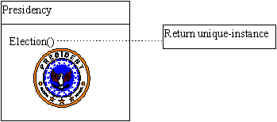
Non-software examples of Singleton Pattern
The Singleton pattern ensures that a class has only one instance and provides a global point of access to that instance. It is named after the singleton set, which is defined to be a set containing one element. The office of the President of the United States is a Singleton. The United States Constitution specifies the means by which a president is elected, limits the term of office, and defines the order of succession. As a result, there can be at most one active president at any given time. Regardless of the personal identity of the active president, the title, "The President of the United States" is a global point of access that identifies the person in the office
Notes:
Implementation of a singleton pattern must satisfy the single instance and global access principles.
It requires a mechanism to access the singleton class member without creating a class object and a mechanism to persist the value of class members among class objects.
The singleton pattern is implemented by creating a class with a method that creates a new instance of the class if one does not exist.
If an instance already exists, it simply returns a reference to that object. To make sure that the object cannot be instantiated any other way, the constructor is made protected

Slide 79
Scenario on Singleton Pattern
A very simple example is say Logger, suppose we need to implement the logger and log it to some file according to date time. In this case, we cannot have more than one instances of Logger in the application otherwise the file in which we need to log will be created with every instance.
We use Singleton pattern for this and instantiate the logger when the first request hits or when the server is started.

Slide 80
Singleton Pattern : Demo

Slide 81
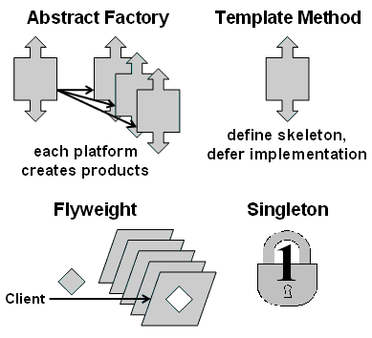
Flyweight Pattern
Flyweight is a software design pattern.
Make instances of classes on the fly to improve performance efficiently.
A flyweight is an object that minimizes memory use ,by sharing as much data as possible with other similar objects;
it is a way to use objects in large numbers when a simple repeated representation would use an unacceptable amount of memory.
The term comes from the boxing weight class with the same name.
Often some parts of the object state can be shared and it's common to put them in external data structures and pass them to the flyweight objects temporarily when they are used.

Slide 82
Flyweight design pattern:
Purpose
Use sharing to support large numbers of fine-grained objects efficiently.
Applications
An application uses a large number of objects.
Storage costs are high because of the sheer quantity of objects.
Most object state can be made extrinsic.
Many groups of objects may be replaced by relatively few shared objects once extrinsic state is removed.
The application doesn't depend on object identity. Since flyweight objects may be shared, identity tests will return true for conceptually distinct objects.
Notes:
Consequences
the reduction in the total number of instances that comes from sharing
the amount of intrinsic state per object
whether extrinsic state is computed or stored.

Slide 83
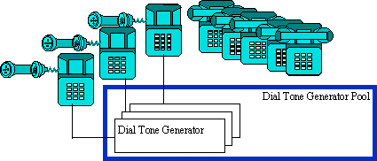
Non-software examples of Flyweight Pattern
The Flyweight uses sharing to support large numbers of objects efficiently. The public switched telephone network is an example of a Flyweight. There are several resources such as dial tone generators, ringing generators, and digit receivers that must be shared between all subscribers. A subscriber is unaware of how many resources are in the pool when he or she lifts the handset to make a call. All that matters to subscribers is that a dial tone is provided, digits are received, and the call is completed
Notes:
when dozens of instances of a class are desired and performance boggs down, externalize object state that is peculiar for each instance, and require the client to pass that state when methods are invoked
----------------------------
Check list
Ensure that object overhead is an issue needing attention, and, the client of the class is able and willing to absorb responsibility realignment.
Divide the target class's state into: shareable (intrinsic) state, and non-shareable (extrinsic) state.
Remove the non-shareable state from the class attributes, and add it the calling argument list of affected methods.
Create a Factory that can cache and reuse existing class instances.
The client must use the Factory instead of the new operator to request objects.
The client (or a third party) must look-up or compute the non-shareable state, and supply that state to class methods.
---------------
Rules of thumb
Whereas Flyweight shows how to make lots of little objects, Facade shows how to make a single object represent an entire subsystem. [GoF, p138]Flyweight is often combined with Composite to implement shared leaf nodes. [GoF, p206]
Terminal symbols within Interpreter's abstract syntax tree can be shared with Flyweight. [GoF. p255]
Flyweight explains when and how State objects can be shared. [GoF, p313]

Slide 84
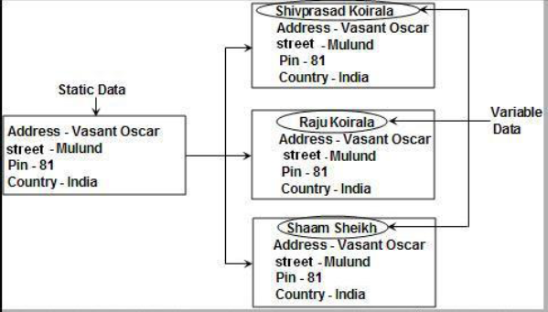
Scenario on Flyweight Pattern

Slide 85
There are cases in programming where it seems that you need to generate a very large number of small class instances to represent data.
Sometimes you can greatly reduce the number of different classes that you need to instantiate if you can recognize that the instances are fundamentally the same except for a few parameters.
If you can move those variables outside the class instance and pass them in as part of a method call, the number of separate instances can be greatly reduced.

Slide 86
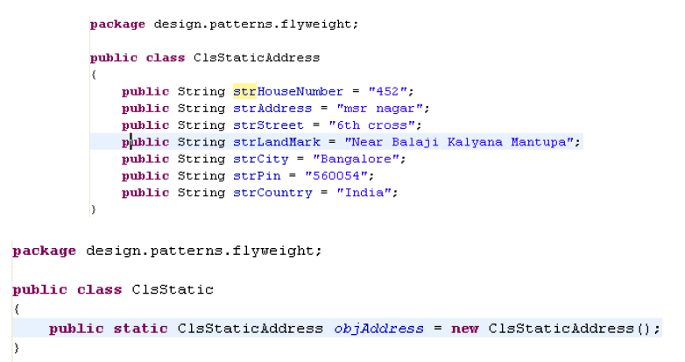

Slide 87
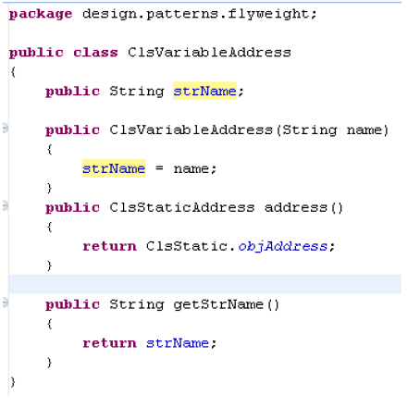
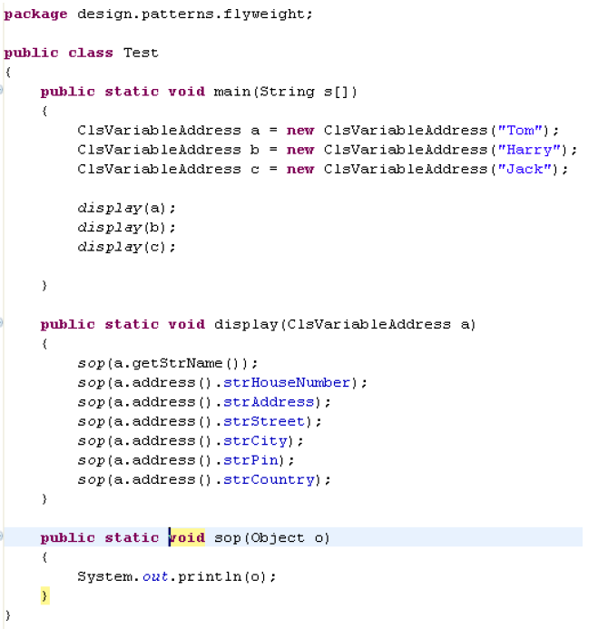

Slide 88
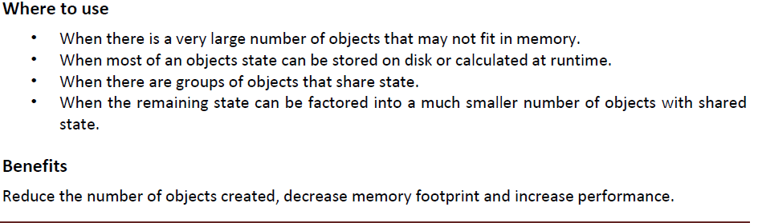

Slide 89
Flyweight Pattern : Demo

Slide 90
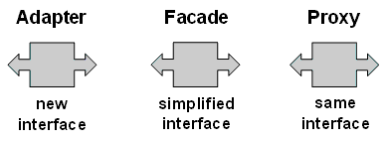
Adapter Pattern
Convert the existing interfaces to a new interface to achieve compatibility and reusability of the unrelated classes in one application
The Adapter design pattern lets you adapt what an object or class has to offer so that another object or class can make use of it.
In computer programming, the adapter design pattern (often referred to as the wrapper pattern or simply a wrapper) translates one interface for a class into a compatible interface.
An adapter allows classes to work together that normally could not because of incompatible interfaces, by providing its interface to clients while using the original interface.
The adapter translates calls to its interface into calls to the original interface, and the amount of code necessary to do this is typically small. The adapter is also responsible for transforming data into appropriate forms

Slide 91
Adapter design pattern:
Purpose
Convert the interface of a class into another interface clients expect.
Adapter lets classes work together that couldn't otherwise because of incompatible interfaces.
Applications
you want to use an existing class, and its interface does not match the one you need.
you want to create a reusable class that cooperates with unrelated or unforeseen classes, that is, classes that don't necessarily have compatible interfaces.
(object adapter only) you need to use several existing subclasses, but it's impractical to adapt their interface by subclassing every one. An object adapter can adapt the interface of its parent class.
Notes:
Consequences
Class and object adapters have different trade-offs.
1. A class adapter
adapts Adaptee to Target by committing to a concrete Adapter class. As a consequence, a class adapter won't work when we want to adapt a class and all its subclasses.
lets Adapter override some of Adaptee's behavior, since Adapter is a subclass of Adaptee.
introduces only one object, and no additional pointer indirection is needed to get to the adaptee.
2. An object adapter
lets a single Adapter work with many Adaptees—that is, the Adaptee itself and all of its subclasses (if any). The Adapter can also add functionality to all Adaptees at once.

Slide 92
In the class-diagram
•A Client class expects a certain interface (called the Target interface)
•An available interface doesn't match the Target interface
•An Adapter class bridges the gap between the Target interface and the available interface
•The available interface is called the Adaptee

Slide 93
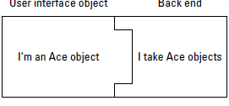
Scenario
“Alright,” says the MegaGigaCo team leader, entering the room, “hold everything.
Management has decreed that we switch our back-end framework to
the one sold by the CEO’s nephew’s company.”
“Hmm,” says a programmer, “that could be a problem. Our online user interface takes customer orders using software from the Ace company and packages them in objects of the Ace class. What type of objects can we pass to the new back end?”
“Only the new Acme objects,” the team leader says, “not Ace objects.”
“Uh oh,” everyone says. “There go our jobs.”
You can see the problem. Currently, the Ace objects that are passed to the back end fit right in, as shown in Figure

Slide 94
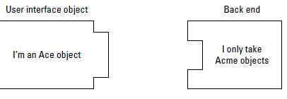
wrap a legacy object that provides an incompatible interface with an object that supports the desired interface
But when the back end is switched to take Acme objects (instead of Ace
objects), the current Ace objects created by the user interface won’t fit.
That scenario looks like Figure

Slide 95
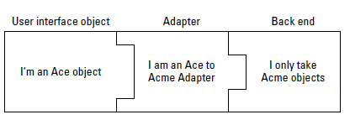
solution

Slide 96
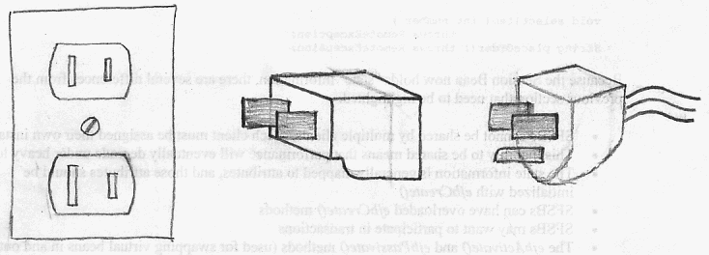
It is like the problem of inserting a new three-prong electrical plug in an old two-prong wall outlet – some kind of adapter or intermediary is necessary.

Slide 97
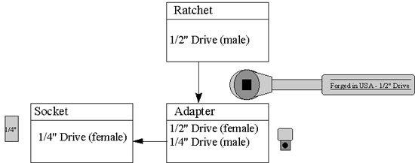
Non-software examples of Adapter Pattern
The Adapter pattern allows otherwise incompatible classes to work together by converting the interface of one class into an interface expected by the clients. Socket wrenches provide an example of the Adapter. A socket attaches to a ratchet, provided that the size of the drive is the same. Typical drive sizes in the United States are 1/2" and 1/4". Obviously, a 1/2" drive ratchet will not fit into a 1/4" drive socket unless an adapter is used. A 1/2" to 1/4" adapter has a 1/2" female connection to fit on the 1/2" drive ratchet, and a 1/4" male connection to fit in the 1/4" drive socket.
Notes:
Check list
Identify the players: the component(s) that want to be accommodated (i.e. the client), and the component that needs to adapt (i.e. the adaptee).
Identify the interface that the client requires.
Design a "wrapper" class that can "impedance match" the adaptee to the client.
The adapter/wrapper class "has a" instance of the adaptee class.
The adapter/wrapper class "maps" the client interface to the adaptee interface.
The client uses (is coupled to) the new interface
----------------
Rules of thumb
Adapter makes things work after they're designed; Bridge makes them work before they are. [GoF, p219]Bridge is designed up-front to let the abstraction and the implementation vary independently. Adapter is retrofitted to make unrelated classes work together. [GoF, p161]
Adapter provides a different interface to its subject. Proxy provides the same interface. Decorator provides an enhanced interface. [GoF. p216]
Adapter is meant to change the interface of an existing object. Decorator enhances another object without changing its interface. Decorator is thus more transparent to the application than an adapter is. As a consequence, Decorator supports recursive composition, which isn't possible with pure Adapters. [GoF, 149]
Facade defines a new interface, whereas Adapter reuses an old interface. Remember that Adapter makes two existing interfaces work together as opposed to defining an entirely new one. [GoF, pp219]

Slide 98
Scenario on AdapterPattern

Slide 99
Fixing Connection Problems with Adapters
The Adapter design pattern lets you fix the interface between objects and classes without having to modify the objects or classes directly.
When you’re working with store-bought applications, you often can’t get inside to alter what one application produces to make it more palatable to another application.

Slide 100
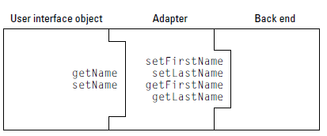
Problem Statement
How the Adapter pattern works is best seen in an example. Currently, the
MegaGigaCo user interface, which I discuss in previous sections of this chapter,
packages user data in objects of the Ace class. This class handles customer
names with these two methods:
setName
getName
But, as you know, MegaGigaCo is switching to Acme software for the back
end, which has to be able to handle customer orders in a different way. The
problem is that the Acme back end expects customer orders to be packaged
in Acme objects. And Acme objects use four methods, not two, to handle the
customer’s name. They are:
setFirstName
setLastName
getFirstName
getLastName

Slide 101
Adapter Pattern : Demo

Slide 102
Façade Pattern
The facade pattern is a software engineering design pattern commonly used with Object-oriented programming. (The name is by analogy to an architectural facade.)
A facade is an object that provides a simplified interface to a larger body of code, such as a class library.
A facade can: make a software library easier to use and understand, since the facade has convenient methods for common tasks;
make code that uses the library more readable, for the same reason;
reduce dependencies of outside code on the inner workings of a library, since most code uses the facade, thus allowing more flexibility in developing the system;
wrap a poorly-designed collection of APIs with a single well-designed API (as per task needs).
An Adapter is used when the wrapper must respect a particular interface and must support a polymorphic behavior. On the other hand, a facade is used when one wants an easier or simpler interface to work with.

Slide 103
Facade design pattern:
Purpose
Provide a unified interface to a set of interfaces in a subsystem. Facade defines a higher-level interface that makes the subsystem easier to use.
Applications
you want to provide a simple interface to a complex subsystem. Subsystems often get more complex as they evolve. Most patterns, when applied, result in more and smaller classes. This makes the subsystem more reusable and easier to customize, but it also becomes harder to use for clients that don't need to customize it. A facade can provide a simple default view of the subsystem that is good enough for most clients. Only clients needing more customizability will need to look beyond the facade.
there are many dependencies between clients and the implementation classes of an abstraction. Introduce a facade to decouple the subsystem from clients and other subsystems, thereby promoting subsystem independence and portability.
Notes:
Consequences
It shields clients from subsystem components, thereby reducing the number of objects that clients deal with and making the subsystem easier to use.
It promotes weak coupling between the subsystem and its clients. Often the components in a subsystem are strongly coupled. Weak coupling lets you vary the components of the subsystem without affecting its clients. Facades help layer a system and the dependencies between objects. They can eliminate complex or circular dependencies. This can be an important consequence when the client and the subsystem are implemented independently.
It doesn't prevent applications from using subsystem classes if they need to. Thus you can choose between ease of use and generality.

Slide 104
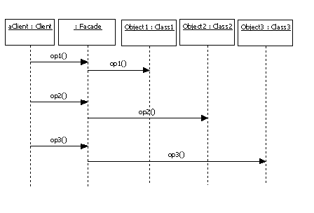
Interaction

Slide 105

Non-software examples of Facade Pattern
The Facade defines a unified, higher level interface to a subsystem that makes it easier to use. Consumers encounter a Facade when ordering from a catalog. The consumer calls one number and speaks with a customer service representative. The customer service representative acts as a Facade, providing an interface to the order fulfillment department, the billing department, and the shipping department.
Notes:
wrap a complicated subsystem with an object that provides a simple interface
----------
Check list
Identify a simpler, unified interface for the subsystem or component.
Design a “wrapper” class that encapsulates the subsystem.
The facade/wrapper captures the complexity and collaborations of the component, and delegates to the appropriate methods.
The client uses (is coupled to) the Façade only.
Consider whether additional Facades would add value.
---------------
Rules of thumb
Facade defines a new interface, whereas Adapter uses an old interface. Remember that Adapter makes two existing interfaces work together as opposed to defining an entirely new one. [GoF, p219]Whereas Flyweight shows how to make lots of little objects, Facade shows how to make a single object represent an entire subsystem. [GoF, p138]
Mediator is similar to Facade in that it abstracts functionality of existing classes. Mediator abstracts/centralizes arbitrary communications between colleague objects. It routinely "adds value", and it is known/referenced by the colleague objects. In contrast, Facade defines a simpler interface to a subsystem, it doesn't add new functionality, and it is not known by the subsystem classes. [GoF. p193]
Abstract Factory can be used as an alternative to Facade to hide platform-specific classes. [GoF, p193]
Facade objects are often Singletons because only one Facade object is required. [GoF, p193]
Adapter and Facade are both wrappers; but they are different kinds of wrappers. The intent of Facade is to produce a simpler interface, and the intent of Adapter is to design to an existing interface. While Facade routinely wraps multiple objects and Adapter wraps a single object; Facade could front-end a single complex object and Adapter could wrap several legacy objects. [Design Patterns Explained, p105]
Question: So the way to tell the difference between the Adapter pattern and the Facade pattern is that the Adapter wraps one class and the Facade may represent many classes? Answer: No! Remember, the Adapter pattern changes the interface of one or more classes into one interface that a client is expecting. While most textbook examples show the adapter adapting one class, you may need to adapt many classes to provide the interface a client is coded to. Likewise, a Facade may provide a simplified interface to a single class with a very complex interface. The difference between the two is not in terms of how many classes they "wrap", it is in their intent. [Head First Design Patterns, p260]

Slide 106
Scenario on Facade Pattern
Let’s consider a store. This store has a store keeper. In the storage, there are a lot of things stored e.g. packing material, raw material and finished goods. You, as client want access to different goods. You do not know where the different materials are stored. You just have access to store keeper who knows his store well. Whatever you want, you tell the store keeper and he takes it out of store and hands it over to you on showing him the credentials. Here, the store keeper acts as the facade, as he hides the complexities of the system Store.

Slide 107



Slide 109
In my experience the common mistakes I have seen is,
just for the sake of introducing a facade layer developers tend to create additional classes. Layered architecture is good but assess the need for every layer.
Creating a java class and ‘forcing’ the UI to interact with other layers through it and calling it a facade layer is one more popular mistake. Facade layer should not be forced and its always optional. If the client wishes to interact with components directly it should be allowed to bypass the facade layer.
Methods in facade layer has only one or two lines which calls the other components. If facade is going to be so simple it invalidates its purpose and clients can directly do that by themselves.
A controller is not a facade.
Facade is ‘not’ a layer that imposes security and hides important data and implementation.
Don’t create a facade layer in advance. If you feel that in future the subsystem is going to evolve and become complicated to defend that do not create a stub class and name it a facade. After the subsystem has become complex you can implement the facade design pattern.
Subsystems are not aware of facade and there should be no reference for facade in subsystems.

Slide 110


Slide 111



Slide 112
Facade Pattern : Demo

Slide 113
Template Method
You use the Template Method design pattern when you’ve got an algorithm of several steps and you want to allow customization by subclasses.
It’s that easy. Implement the steps in that algorithm as an overridable method calls in an abstract class, and let the subclasses override those steps as required.
The Template Method pattern is great when you have a multi-step algorithm to implement that you also want to customize
Sub classes cant change the sequence of algorithm.

Slide 114
Template design pattern:
Purpose
Define the skeleton of an algorithm in an operation, deferring some steps to subclasses.
Template Method lets subclasses redefine certain steps of an algorithm without changing the algorithm's structure.
Applications
to implement the invariant parts of an algorithm once and leave it up to subclasses to implement the behavior that can vary.
when common behavior among subclasses should be factored and localized in a common class to avoid code duplication. This is a good example of "refactoring to generalize" as described by Opdyke and Johnson. You first identify the differences in the existing code and then separate the differences into new operations. Finally, you replace the differing code with a template method that calls one of these new operations.
to control subclasses extensions. You can define a template method that calls "hook" operations (see Consequences) at specific points, thereby permitting extensions only at those points.
Notes:
Consequences
Template methods are a fundamental technique for code reuse. They are particularly important in class libraries, because they are the means for factoring out common behavior in library classes.
Template methods lead to an inverted control structure that's sometimes referred to as "the Hollywood principle," that is, "Don't call us, we'll call you" . This refers to how a parent class calls the operations of a subclass and not the other way around.

Slide 115

Non-software examples of Template Pattern
The Template Method defines a skeleton of an algorithm in an operation, and defers some steps to subclasses. Home builders use the Template Method when developing a new subdivision. A typical subdivision consists of a limited number of floor plans with different variations available for each. Within a floor plan, the foundation, framing, plumbing, and wiring will be identical for each house. Variation is introduced in the later stages of construction to produce a wider variety of models.
Notes:
define the "outline" of an algorithm in a base class ... common implementation is staged in the base class, peculiar implementation is represented by "place holders" in the base class and then implemented in derived classes
-------------------
heck list
Examine the algorithm, and decide which steps are standard and which steps are peculiar to each of the current classes.
Define a new abstract base class to host the "don't call us, we'll call you" framework.
Move the shell of the algorithm (now called the "template method") and the definition of all standard steps to the new base class.
Define a placeholder or "hook" method in the base class for each step that requires many different implementations. This method can host a default implementation – or – it can be defined as abstract (Java) or pure virtual (C++).
Invoke the hook method(s) from the template method.
Each of the existing classes declares an "is-a" relationship to the new abstract base class.
Remove from the existing classes all the implementation details that have been moved to the base class.
The only details that will remain in the existing classes will be the implementation details peculiar to each derived class.
-------------------
Rules of thumb
Strategy is like Template Method except in its granularity. [Coplien, C++ Report, Mar 96, p88]Template Method uses inheritance to vary part of an algorithm. Strategy uses delegation to vary the entire algorithm. [GoF, p330]
Strategy modifies the logic of individual objects. Template Method modifies the logic of an entire class. [Grand, p383]
Factory Method is a specialization of Template Method. [Head First Design Patterns, p311]

Slide 116
Scenario on Template Pattern

Slide 117
Template Pattern : Demo

Slide 118
Builder Design Pattern
Use the Builder design pattern when you want client code to have control over the construction process but want to be able to end up with different kinds of objects (each of which is built by a different type of builder).
For example, this is the pattern you want when you’re building robots using the same construction process but want to be able to end up with different kinds of robots — all the client code has to do is to load different builders; the construction process stays the same
Builder pattern is useful when the construction of the object is very complex. The main objective is to separate the construction of objects and their representations. If we are able to separate the construction and representation, we can then get many representations from the same construction.
Notes:
Builder, as the name suggests builds complex objects from simple ones step-by-step. It separates the construction of complex objects from their representation.

Slide 119
Builder design pattern:
Purpose
Separate the construction of a complex object from its representation so that the same construction process can create different representations
Applications
The algorithm for creating a complex object should be independent of the parts that make up the object and how they're assembled.
The construction process must allow different representations for the object that's constructed
Notes:
Consequences
It lets you vary a product's internal representation. The Builder object provides the director with an abstract interface for constructing the product. The interface lets the builder hide the representation and internal structure of the product. It also hides how the product gets assembled. Because the product is constructed through an abstract interface, all you have to do to change the product's internal representation is define a new kind of builder.
t isolates code for construction and representation. I The Builder pattern improves modularity by encapsulating the way a complex object is constructed and represented. Clients needn't know anything about the classes that define the product's internal structure; such classes don't appear in Builder's interface.
It gives you finer control over the construction process. Unlike creational patterns that construct products in one shot, the Builder pattern constructs the product step by step under the director's control. Only when the product is finished does the director retrieve it from the builder. Hence the Builder interface reflects the process of constructing the product more than other creational patterns. This gives you finer control over the construction process and consequently the internal structure of the resulting product.

Slide 120

Interaction

Slide 121

Non-software examples of Builder Pattern
The Builder pattern separates the construction of a complex object from its representation so that the same construction process can create different representations. This pattern is used by fast food restaurants to construct children's meals. Children's meals typically consist of a main item, a side item, a drink, and a toy (e.g., a hamburger, fries, Coke, and toy car). Note that there can be variation in the content of the children's meal, but the construction process is the same. Whether a customer orders a hamburger, cheeseburger, or chicken, the process is the same. The employee at the counter directs the crew to assemble a main item, side item, and toy. These items are then placed in a bag. The drink is placed in a cup and remains outside of the bag. This same process is used at competing restaurants.
Notes:
the "reader" delegates to its configured "builder" ... each builder corresponds to a different representation or target
------------
Check list
Decide if a common input and many possible representations (or outputs) is the problem at hand.
Encapsulate the parsing of the common input in a Reader class.
Design a standard protocol for creating all possible output representations. Capture the steps of this protocol in a Builder interface.
Define a Builder derived class for each target representation.
The client creates a Reader object and a Builder object, and registers the latter with the former.
The client asks the Reader to "construct".
The client asks the Builder to return the result.
----------------------
Rules of thumb
Sometimes creational patterns are complementory: Builder can use one of the other patterns to implement which components get built. Abstract Factory, Builder, and Prototype can use Singleton in their implementations. [GoF, p81, 134]Builder focuses on constructing a complex object step by step. Abstract Factory emphasizes a family of product objects (either simple or complex). Builder returns the product as a final step, but as far as the Abstract Factory is concerned, the product gets returned immediately. [GoF, p105]
Builder often builds a Composite. [GoF, p106]
Often, designs start out using Factory Method (less complicated, more customizable, subclasses proliferate) and evolve toward Abstract Factory, Prototype, or Builder (more flexible, more complex) as the designer discovers where more flexibility is needed. [GoF, p136]

Slide 122


Slide 123


Slide 124
The construction process is same for both the types of reports but they result in different representations.
There are three main parts when you want to implement builder patterns.
• Builder - Builder is responsible for defining the construction process for individual parts. Builder has those individual processes to initialize and configure the product.
• Director - Director takes those individual processes from the builder and defines the sequence to build the product.
• Product - Product is the final object which is produced from the builder and director coordination.

Slide 125
Scenario on Builder Pattern
Say, we have to plan for a children meal at a fast food restaurant. What is it comprised of? Well, a burger, a cold drink, a medium fries and a toy.
This is common to all the fast food restaurants and all the children meals. Here, what is important? Every time a children’s meal is ordered, the service boy will take a burger, a fries, a cold drink and a toy. Now suppose, there are 3 types of burgers available. Vegetable, Fish and Chicken, 2 types of cold drinks available. Cola and Orange and 2 types of toys available, a car and a doll.
So, the order might be a combination of one of these, but the process will be the same. One burger, one cold drink, one fries and one toy. All these items are placed in a paper bag and is given to the customer.

Slide 126
The main difference between the Template Method and the Builder design patterns is in who creates the sequence of steps in the algorithm.
In the Template Method, you do, and subclasses can make alterations. In the Builder pattern, the client code sets the sequence and number of steps in the algorithm and swaps between the builders you provide to create various objects that embody that algorithm.
Notes:
This pattern is similar to the Factory pattern, also one of the GoF patterns,
but the Factory pattern can be more involved, and it centers on a single-step
creation process, not a configurable sequence of steps, as here

Slide 127


Slide 128
Builder Pattern : Demo

Slide 129

Command pattern
In object-oriented programming, the command pattern is a design pattern in which an object is used to represent and encapsulate all the information needed to call a method at a later time.
This information includes the method name, the object that owns the method and values for the method parameters.
Three terms always associated with the command pattern are client, invoker and receiver.
The client instantiates the command object and provides the information required to call the method at a later time.
The invoker decides when the method should be called.
The receiver is an instance of the class that contains the method's code.
Using command objects makes it easier to construct general components that need to delegate, sequence or execute method calls at a time of their choosing without the need to know the owner of the method or the method parameters.
Notes:
This is another of the data-driven pattern. The client invokes a particular module using a command. The client passes a request, this request gets propagated as a command. The command request maps to particular modules. According to the command, a module is invoked.

Slide 130
The Chain of Responsibility pattern forwards requests along a chain of classes, but the Command pattern forwards a request only to a specific module
It encloses a request for a specific action inside an object and gives it a known public interface.
It lets you give the client the ability to make requests without knowing anything about the actual action that will be performed, and allows you to change that action without affecting the client program in any way

Slide 131


Slide 132
Command design pattern:
Purpose
Encapsulate a request as an object, thereby letting you parameterize clients with different requests, queue or log requests, and support undoable operations.
Applications
parameterize objects by an action to perform, as MenuItem objects did above. You can express such parameterization in a procedural language with a callback function, that is, a function that's registered somewhere to be called at a later point. Commands are an object-oriented replacement for callbacks.
specify, queue, and execute requests at different times. A Command object can have a lifetime independent of the original request. If the receiver of a request can be represented in an address space-independent way, then you can transfer a command object for the request to a different process and fulfill the request there.
Notes:
Consequences
Command decouples the object that invokes the operation from the one that knows how to perform it.
Commands are first-class objects. They can be manipulated and extended like any other object.
You can assemble commands into a composite command. An example is the MacroCommand class described earlier.
It's easy to add new Commands, because you don't have to change existing classes.

Slide 133
More Applicatons
support undo. The Command's Execute operation can store state for reversing its effects in the command itself. The Command interface must have an added Unexecute operation that reverses the effects of a previous call to Execute. Executed commands are stored in a history list. Unlimited-level undo and redo is achieved by traversing this list backwards and forwards calling Unexecute and Execute, respectively.
support logging changes so that they can be reapplied in case of a system crash. By augmenting the Command interface with load and store operations, you can keep a persistent log of changes. Recovering from a crash involves reloading logged commands from disk and reexecuting them with the Execute operation.

Slide 134

Interaction
The client creates a ConcreteCommand object and specifies its receiver.
An Invoker object stores the ConcreteCommand object.
The invoker issues a request by calling Execute on the command. When commands are undoable, ConcreteCommand stores state for undoing the command prior to invoking Execute.
The ConcreteCommand object invokes operations on its receiver to carry out the request.

Slide 135

Non-software examples of Command
The Command pattern allows requests to be encapsulated as objects, thereby allowing clients to be parameterized with different requests. The "check" at a diner is an example of a Command pattern. The waiter or waitress takes an order or command from a customer and encapsulates that order by writing it on the check. The order is then queued for a short order cook. Note that the pad of "checks" used by each waiter is not dependent on the menu, and therefore they can support commands to cook many different items.
Notes:
Check list
Define a Command interface with a method signature like execute().
Create one or more derived classes that encapsulate some subset of the following: a "receiver" object, the method to invoke, the arguments to pass.
Instantiate a Command object for each deferred execution request.
Pass the Command object from the creator (aka sender) to the invoker (aka receiver).
The invoker decides when to execute().
-------------------
Rules of thumb
Chain of Responsibility, Command, Mediator, and Observer, address how you can decouple senders and receivers, but with different trade-offs. Command normally specifies a sender-receiver connection with a subclass.Chain of Responsibility can use Command to represent requests as objects. [GoF, p349].
Command and Memento act as magic tokens to be passed around and invoked at a later time. In Command, the token represents a request; in Memento, it represents the internal state of an object at a particular time. Polymorphism is important to Command, but not to Memento because its interface is so narrow that a memento can only be passed as a value. [GoF, p346]
Command can use Memento to maintain the state required for an undo operation. [GoF, p242]
MacroCommands can be implemented with Composite. [GoF, p242]
A Command that must be copied before being placed on a history list acts as a Prototype. [GoF, p242]
POSA's Command Processor pattern describes the scaffolding Command needs to support full multilevel undo and redo. [Vlissides, Java Report, Nov 2000, p80]
Two important aspects of the Command pattern: interface separation (the invoker is isolated from the receiver), time separation (stores a ready-to-go processing request that's to be stated later). [Alexandrescu, p101]

Slide 136



Slide 137


Slide 138


Slide 139


Slide 140

A Command class holds some subset of the following: an object, a method to be applied to the object, and the arguments to be passed when the method is applied. The Command's "execute" method then causes the pieces to come together.

Slide 141
Scenario on Command Pattern
It’s like there is a server having a lot of services to be given, and on Demand (or on command), it caters to that service for that particular client. A classic example of this is a restaurant. A customer goes to restaurant and orders the food according to his/her choice. The waiter/ waitress takes the order (command, in this case) and hands it to the cook in the kitchen. The cook can make several types of food and so, he/she prepares the ordered item and hands it over to the waiter/waitress who in turn serves to the customer.
Notes:
Usage of Command DP
Transactional behavior Undo is perhaps even more essential when it's called rollback and happens automatically when an operation fails partway through. Installers need this and so do databases. Command objects can also be used to implement two-phase commit.
Progress bars Suppose a program has a sequence of commands that it executes in order. If each command object has a getEstimatedDuration() method, the program can easily estimate the total duration. It can show a progress bar that meaningfully reflects how close the program is to completing all the tasks.

Slide 142


Slide 143
Command Pattern : Demo

Slide 144

Mediator pattern
With the mediator pattern communication between objects is encapsulated with a mediator object.
Objects no longer communicate directly with each other, but instead communicate through the mediator.
This reduces the dependencies between communicating objects, thereby lowering the coupling.
Notes:
The mediator pattern deals with the complexity which comes in the coding when number of classes increase. I will explain thisother producing results. Now, consider slowly, the logic becomes more complex and functionality increases. . When we begin with development, we have a few classes and these classes interact with each Then what happens? We add more classes and they still interact with each other but it gets really difficult to maintain this code now. Mediator pattern takes care of this problem. It makes the code more maintainable. It promotes loose-coupling of classes such that only one class (Mediator) has the knowledge of all the classes, rest of the classes have their responsibilities and they only interact with the Mediator.

Slide 145
Mediator design pattern:
Purpose
Define an object that encapsulates how a set of objects interact.
Mediator promotes loose coupling by keeping objects from referring to each other explicitly, and it lets you vary their interaction independently.
Applications
a set of objects communicate in well-defined but complex ways. The resulting interdependencies are unstructured and difficult to understand.
l reusing an object is difficult because it refers to and communicates with many other objects.
a behavior that's distributed between several classes should be customizable without a lot of subclassing.
Notes:
Consequences
It limits subclassing. A mediator localizes behavior that otherwise would be distributed among several objects. Changing this behavior requires subclassing Mediator only; Colleague classes can be reused as is.
It decouples colleagues. A mediator promotes loose coupling between colleagues. You can vary and reuse Colleague and Mediator classes independently.
It simplifies object protocols. A mediator replaces many-to-many interactions with one-to-many interactions between the mediator and its colleagues. One-to-many relationships are easier to understand, maintain, and extend.
It abstracts how objects cooperate. Making mediation an independent concept and encapsulating it in an object lets you focus on how objects interact apart from their individual behavior. That can help clarify how objects interact in a system.
It centralizes control. The Mediator pattern trades complexity of interaction for complexity in the mediator. Because a mediator encapsulates protocols, it can become more complex than any individual colleague. This can make the mediator itself a monolith that's hard to maintain.

Slide 146

Interaction
Here's the succession of events by which a list box's selection passes to an entry field.
The list box tells its director that it's changed.
The director gets the selection from the list box.
The director passes the selection to the entry field.
Now that the entry field contains some text, the director enables button(s) for initiating an action

Slide 147

Non-software examples of Mediator
The Mediator defines an object that controls how a set of objects interact. Loose coupling between colleague objects is achieved by having colleagues communicate with the Mediator, rather than with each other. The control tower at a controlled airport demonstrates this pattern very well. The pilots of the planes approaching or departing the terminal area communicate with the tower rather than explicitly communicating with one another. The constraints on who can take off or land are enforced by the tower. It is important to note that the tower does not control the whole flight. It exists only to enforce constraints in the terminal area

Slide 148


In Unix, permission to access system resources is managed at three levels of granularity: world, group, and owner. A group is a collection of users intended to model some functional affiliation. Each user on the system can be a member of one or more groups, and each group can have zero or more users assigned to it.

Slide 149
Scenario on Mediator Pattern
A very common example can be airplanes interacting with the control tower and not among themselves. The control tower knows exactly, where each of the airplanes is, and guides them whereas the airplanes have their own responsibilities of landing and takeoff. Another popular example is Stock exchange. In old days when there were no stock markets, the individual brokers used to buy or sell commodities among themselves. They used to face huge risks, of defaulting of counterparty, limited information (as, only limited deals in limited areas were possible), limited geographical reach, price variance (everyone could quote whatever price they wanted) and many more.
So, the concept of stock exchange came into play. For ex: BSE or NSE in India and NYSE, NASDAQ etc in the US. The stock exchange started acting like a mediator and the traders did not need to know other traders and services provided by them to make a deal. The traders have their own responsibilities as buyers and sellers and it was stock exchange’s responsibility to match their deals and get the settlement done. Many of the above mentioned risks were mitigated by this. But, there were some standardization procedures which came into picture because of this. All the traders who wanted to deal on stock exchange had to follow these standardization procedures.

Slide 150
Mediator Pattern : Demo

Slide 151

Memento pattern
The memento pattern is a software design pattern that provides the ability to restore an object to its previous state (undo via rollback).
The memento pattern is used by two objects: the originator and a caretaker.
The originator is some object that has an internal state.
The caretaker is going to do something to the originator, but wants to be able to undo the change.
The caretaker first asks the originator for a memento object. Then it does whatever operation (or sequence of operations) it was going to do.
To roll back to the state before the operations, it returns the memento object to the originator. The memento object itself is an opaque object (one which the caretaker can not, or should not, change). When using this pattern, care should be taken if the originator may change other objects or resources - the memento pattern operates on a single object.

Slide 152
Memento design pattern:
Purpose
Define an object that encapsulates how a set of objects interact.
Mediator promotes loose coupling by keeping objects from referring to each other explicitly, and it lets you vary their interaction independently.
Applications
a set of objects communicate in well-defined but complex ways. The resulting interdependencies are unstructured and difficult to understand.
l reusing an object is difficult because it refers to and communicates with many other objects.
a behavior that's distributed between several classes should be customizable without a lot of subclassing.
Notes:
Consequences
It limits subclassing. A mediator localizes behavior that otherwise would be distributed among several objects. Changing this behavior requires subclassing Mediator only; Colleague classes can be reused as is.
It decouples colleagues. A mediator promotes loose coupling between colleagues. You can vary and reuse Colleague and Mediator classes independently.
It simplifies object protocols. A mediator replaces many-to-many interactions with one-to-many interactions between the mediator and its colleagues. One-to-many relationships are easier to understand, maintain, and extend.
It abstracts how objects cooperate. Making mediation an independent concept and encapsulating it in an object lets you focus on how objects interact apart from their individual behavior. That can help clarify how objects interact in a system.

Slide 153

Non-software examples of Memento
The Memento captures and externalizes an object's internal state so that the object can later be restored to that state. This pattern is common among do-it-yourself mechanics repairing drum brakes on their cars. The drums are removed from both sides, exposing both the right and left brakes. Only one side is disassembled and the other serves as a Memento of how the brake parts fit together. Only after the job has been completed on one side is the other side disassembled. When the second side is disassembled, the first side acts as the Memento
Notes:
Check list
Identify the roles of “caretaker” and “originator”.
Create a Memento class and declare the originator a friend.
Caretaker knows when to "check point" the originator.
Originator creates a Memento and copies its state to that Memento.
Caretaker holds on to (but cannot peek into) the Memento.
Caretaker knows when to "roll back" the originator.
Originator reinstates itself using the saved state in the Memento.
-------------------------
Rules of thumb
Command and Memento act as magic tokens to be passed around and invoked at a later time. In Command, the token represents a request; in Memento, it represents the internal state of an object at a particular time. Polymorphism is important to Command, but not to Memento because its interface is so narrow that a memento can only be passed as a value. [GoF, p346]Command can use Memento to maintain the state required for an undo operation. [GoF, p242]
Memento is often used in conjunction with Iterator. An Iterator can use a Memento to capture the state of an iteration. The Iterator stores the Memento internally. [GoF, p271]

Slide 154
Memento pattern record an object internal state without violating encapsulation and reclaim it later without knowledge of the original object. A memento is an object that stores a snapshot of the internal state of another object.
Suppose you would like to save the internal state of an object so you can restore it later. Ideally, it should be possible to save and restore this state without making the object and without violating encapsulation. This is the purpose of the Memento pattern.

Slide 155
If all of the information describing an object is available in public variables, it is not that difficult to save them in some external store. However, making these data public makes the entire system vulnerable to change by external program code, when we usually expect data inside an object to be private and encapsulated from the outside world.
The Memento pattern attempts to solve this problem by having privileged access to the state of the object you want to save.
Other objects have only a more restricted access to the object, thus preserving their encapsulation. This pattern defines three roles for objects:
1. Originator is the object whose state we want to save.
2. Memento is another object that saves the state of the Originator.
3. Caretaker manages the timing of the saving of the state, saves the Memento and, if needed, uses the Memento to restore the state of the Originator.

Slide 156


Slide 157


Slide 158


Slide 159


Slide 160
Memento Pattern : Demo

Slide 161

Visitor Pattern
In object-oriented programming and software engineering, the visitor design pattern is a way of separating an algorithm from an object structure upon which it operates. A practical result of this separation is the ability to add new operations to existing object structures without modifying those structures. Thus, using the visitor pattern helps conformance with the open/closed principle.
In essence, the visitor allows one to add new virtual functions to a family of classes without modifying the classes themselves; instead, one creates a visitor class that implements all of the appropriate specializations of the virtual function. The visitor takes the instance reference as input, and implements the goal through double dispatch.

Slide 162
Visitor design pattern:
Purpose
Represent an operation to be performed on the elements of an object structure.
Visitor lets you define a new operation without changing the classes of the elements on which it operates.
Applications
an object structure contains many classes of objects with differing interfaces, and you want to perform operations on these objects that depend on their concrete classes.
many distinct and unrelated operations need to be performed on objects in an object structure, and you want to avoid "polluting" their classes with these operations. Visitor lets you keep related operations together by defining them in one class. When the object structure is shared by many applications, use Visitor to put operations in just those applications that need them.
the classes defining the object structure rarely change, but you often want to define new operations over the structure. Changing the object structure classes requires redefining the interface to all visitors, which is potentially costly. If the object structure classes change often, then it's probably better to define the operations in those classes.
Notes:
Consequences
Visitor makes adding new operations easy. Visitors make it easy to add operations that depend on the components of complex objects. You can define a new operation over an object structure simply by adding a new visitor. In contrast, if you spread functionality over many classes, then you must change each class to define a new operation.
A visitor gathers related operations and separates unrelated ones. Related behavior isn't spread over the classes defining the object structure; it's localized in a visitor. Unrelated sets of behavior are partitioned in their own visitor subclasses. That simplifies both the classes defining the elements and the algorithms defined in the visitors. Any algorithm-specific data structures can be hidden in the visitor.
Adding new ConcreteElement classes is hard. The Visitor pattern makes it hard to add new subclasses of Element. Each new ConcreteElement gives rise to a new abstract operation on Visitor and a corresponding implementation in every ConcreteVisitor class. Sometimes a default implementation can be provided in Visitor that can be inherited by most of the ConcreteVisitors, but this is the exception rather than the rule.
Accumulating state. Visitors can accumulate state as they visit each element in the object structure. Without a visitor, this state would be passed as extra arguments to the operations that perform the traversal, or they might appear as global variables.
Breaking encapsulation. Visitor's approach assumes that the ConcreteElement interface is powerful enough to let visitors do their job. As a result, the pattern often forces you to provide public operations that access an element's internal state, which may compromise its encapsulation.

Slide 163

Interaction
A client that uses the Visitor pattern must create a ConcreteVisitor object and then traverse the object structure, visiting each element with the visitor.
When an element is visited, it calls the Visitor operation that corresponds to its class.
The element supplies itself as an argument to this operation to let the visitor access its state, if necessary.

Slide 164

Non-software examples of Visitor
The Visitor pattern represents an operation to be performed on the elements of an object structure without changing the classes on which it operates. This pattern can be observed in the operation of a taxi company. When a person calls a taxi company (accepting a visitor), the company dispatches a cab to the customer. Upon entering the taxi the customer, or Visitor, is no longer in control of his or her own transportation, the taxi (driver) is.

Slide 165
Scenario on Visitor Pattern

Slide 166
Visitor Pattern : Demo

Slide 167

Proxy Pattern
A proxy, in its most general form, is a class functioning as an interface to something else. The proxy could interface to anything: a network connection, a large object in memory, a file, or some other resource that is expensive or impossible to duplicate.
A well-known example of the proxy pattern is a reference counting pointer object.
In situations where multiple copies of a complex object must exist the proxy pattern can be adapted to incorporate the flywe11ight pattern in order to reduce the application's memory footprint. Typically one instance of the complex object is created, and multiple proxy objects are created, all of which contain a reference to the single original complex object. Any operations performed on the proxies are forwarded to the original object. Once all instances of the proxy are out of scope, the complex object's memory may be deallocated.

Slide 168
Proxy design pattern:
Purpose
Provide a surrogate or placeholder for another object to control access to it.
Applications
A remote proxy provides a local representative for an object in a different address space.
A virtual proxy creates expensive objects on demand. The ImageProxy described in the Motivation is an example of such a proxy.
A protection proxy controls access to the original object. Protection proxies are useful when objects should have different access rights.
Notes:
Consequences
The Proxy pattern introduces a level of indirection when accessing an object. The additional indirection has many uses, depending on the kind of proxy:
1. A remote proxy can hide the fact that an object resides in a different address space.
2. A virtual proxy can perform optimizations such as creating an object on demand.
3. Both protection proxies and smart references allow additional housekeeping tasks when an object is accessed.

Slide 169

Non-software examples of Proxy
The Proxy provides a surrogate or place holder to provide access to an object. A check or bank draft is a proxy for funds in an account. A check can be used in place of cash for making purchases and ultimately controls access to cash in the issuer's account
Notes:
Check list
Identify the leverage or “aspect” that is best implemented as a wrapper or surrogate.
Define an interface that will make the proxy and the original component interchangeable.
Consider defining a Factory that can encapsulate the decision of whether a proxy or original object is desirable.
The wrapper class holds a pointer to the real class and implements the interface.
The pointer may be initialized at construction, or on first use.
Each wrapper method contributes its leverage, and delegates to the wrappee object.
------------
Rules of thumb
Adapter provides a different interface to its subject. Proxy provides the same interface. Decorator provides an enhanced interface. [GoF. p216]Decorator and Proxy have different purposes but similar structures. Both describe how to provide a level of indirection to another object, and the implementations keep a reference to the object to which they forward requests. [GoF, p220]

Slide 170
Scenario on Proxy Pattern
Let’ say we need to withdraw money to make some purchase. The way we will do it is, go to an ATM and get the money, or purchase straight with a cheque.
In old days when ATMs and cheques were not available, what used to be the way??? Well, get your passbook, go to bank, get withdrawal form there, stand in a queue and withdraw money. Then go to the shop where you want to make the purchase.
In this way, we can say that ATM or cheque in modern times act as proxies to the Bank.

Slide 171
A proxy is a class functioning as an interface to something else.
The proxy could interface to the resource that is expensive or impossible to duplicate.
This actual object can be a huge image or a data object which is very large and cannot be duplicated.
So you can create multiple proxies and point towards the actual object (memory consuming object) and perform operations.
This avoids duplication of the heavy object and thus saving memory. Proxies are references which points towards the actual object.

Slide 172
There are several cases where a Proxy can be useful. Few of them as follow.
1. If an object, such as a large image, takes a long time to load.
2. If the object is on a remote machine and loading it over the network may be slow, especially during peak network load periods.
3. If the object has limited access rights, the proxy can validate the access permissions for that user.

Slide 173
In proxy pattern, typically one instance of the complex object is created, and multiple proxy objects are created, all of which contain a reference to the single original complex object.
Any operations performed on the proxies are forwarded to the original object.
Once all instances of the proxy are out of scope, the complex object's memory may be deallocated.

Slide 174


Slide 175


Slide 176


Slide 177


Slide 178

Bridge Pattern
The bridge pattern is a design pattern used in software engineering which is meant to "decouple an abstraction from itsimplementation so that the two can vary independently" ^{[1]}. The bridge uses encapsulation, aggregation, and can use inheritance to separate responsibilities into different classes.
When a class varies often, the features of object-oriented programming become very useful because changes to a program's codecan be made easily with minimal prior knowledge about the program. The bridge pattern is useful when both the class as well as what it does varies. The class itself can be thought of as the implementation and what the class can do as the abstraction. The bridge pattern can also be thought of as two layers of abstraction.

Slide 179
Bridge design pattern:
Purpose
Decouple an abstraction from its implementation so that the two can vary independently.
Applications
you want to avoid a permanent binding between an abstraction and its implementation. This might be the case, for example, when the implementation must be selected or switched at run-time.
both the abstractions and their implementations should be extensible by subclassing. In this case, the Bridge pattern lets you combine the different abstractions and implementations and extend them independently.
changes in the implementation of an abstraction should have no impact on clients; that is, their code should not have to be recompiled.
you want to share an implementation among multiple objects (perhaps using reference counting), and this fact should be hidden from the client.
Notes:
Consequences
Decoupling interface and implementation. An implementation is not bound permanently to an interface. The implementation of an abstraction can be configured at run-time. It's even possible for an object to change its implementation at run-time. Decoupling Abstraction and Implementor also eliminates compile-time dependencies on the implementation. Changing an implementation class doesn't require recompiling the Abstraction class and its clients. This property is essential when you must ensure binary compatibility between different versions of aclass library.
Improved extensibility. You can extend the Abstraction and Implementor hierarchies independently.
Hiding implementation details from clients . You can shield clients from implementation details, like the sharing of implementor objects and the accompanying reference count mechanism

Slide 180
At first sight, the bridge pattern looks much like the Adapter pattern, in that a class is used to convert one kind of interface to another. However, the intent of the Adapter pattern is to make one or more classes’ interfaces look the same as that of a particular class.
The Bridge pattern is designed to separate a class’s interface from its implementation, so that you can vary or replace the implementation without changing the client code.

Slide 181
Adapter makes things work after they're designed; Bridge makes them work before they are.
Bridge is designed up-front to let the abstraction and the implementation vary independently. Adapter is retrofitted to make unrelated classes work together.

Slide 182

Example:

Slide 183


Slide 184




Slide 185
Where to use
When you want to separate the abstract structure and its concrete implementation. When you want to share an implementation among multiple objects,
• When you want to reuse existing resources in an 'easy to extend' fashion.
• When you want to hide implementation details from clients. Changes in implementation should have no impact on clients.

Slide 186
Benefits
Implementation can be selected or switched at run-time. The abstraction and implementation can be independently extended or composed.
Drawbacks/consequences
Double indirection - In the example, methods are implemented by subclasses. Super class must delegate the message to a subclass which implements the appropriate method. This will have a slight impact on performance.

Slide 187
Bridge Pattern : Demo

Slide 188
Prototype Pattern
prototype pattern is a creational design pattern used in software development when the type of objects to create is determined by a prototypical instance, which is cloned to produce new objects. This pattern is used to:
avoid subclasses of an object creator in the client application, like the abstract factory pattern does.
avoid the inherent cost of creating a new object in the standard way (e.g., using the 'new' keyword) when it is prohibitively expensive for a given application.
To implement the pattern, declare an abstract base class that specifies a pure virtual clone() method. Any class that needs a "polymorphic constructor" capability derives itself from the abstract base class, and implements the clone() operation.
The client, instead of writing code that invokes the "new" operator on a hard-coded class name, calls the clone() method on the prototype, calls a factory method with a parameterdesignating the particular concrete derived class desired, or invokes the clone() method through some mechanism provided by another design pattern.

Slide 189
Prototype design pattern:
Purpose
Specify the kinds of objects to create using a prototypical instance, and create new objects by copying this prototype
Applications
when the classes to instantiate are specified at run-time, for example, by dynamic loading.
to avoid building a class hierarchy of factories that parallels the class hierarchy of products.
when instances of a class can have one of only a few different combinations of state. It may be more convenient to install a corresponding number of prototypes and clone them rather than instantiating the class manually, each time with the appropriate state.
Notes:
Consequences
Adding and removing products at run-time. Prototypes let you incorporate a new concrete product class into a system simply by registering a prototypical instance with the client. That's a bit more flexible than other creational patterns, because a client can install and remove prototypes at run-time.
Specifying new objects by varying values. Highly dynamic systems let you define new behavior through object composition—by specifying values for an object's variables, for example—and not by defining new classes. You effectively define new kinds of objects by instantiating existing classes and registering the instances as prototypes of client objects. A client can exhibit new behavior by delegating responsibility to the prototype.
Specifying new objects by varying structure. Many applications build objects from parts and subparts. Editors for circuit design, for example, build circuits out of subcircuits.

Slide 190
The Prototype pattern is basically the creation of new instances through cloning existing instances.
By creating a prototype, new objects are created by copying this prototype.
Prototype pattern is used when creating an instance of a class is very time-consuming or complex in some way.
Then, rather than creating more instances, you make copies of the original instance, modifying them as appropriate
By cloning any changes to the cloned object does not affect the original object value.

Slide 191


Slide 192

Non-software examples of Prototype
Notes:
encapsulate use of the "new" operator behind the method signature "clone" ... clients will delegate to a Prototype object when new instances are required
---------------------------
Check list
Add a clone() method to the existing "product" hierarchy.
Design a "registry" that maintains a cache of prototypical objects. The registry could be encapsulated in a new Factory class, or in the base class of the "product" hierarchy.
Design a factory method that: may (or may not) accept arguments, finds the correct prototype object, calls clone() on that object, and returns the result.
The client replaces all references to the new operator with calls to the factory method.
---------------
Rules of thumb
Sometimes creational patterns are competitors: there are cases when either Prototype or Abstract Factory could be used properly. At other times they are complementory: Abstract Factory might store a set of Prototypes from which to clone and return product objects [GOF, p126]. Abstract Factory, Builder, and Prototype can use Singleton in their implementations. [GoF, p81, 134]. Abstract Factory classes are often implemented with Factory Methods, but they can be implemented using Prototype. [GoF, p95]
Factory Method: creation through inheritance. Protoype: creation through delegation.
Often, designs start out using Factory Method (less complicated, more customizable, subclasses proliferate) and evolve toward Abstract Factory, Protoype, or Builder (more flexible, more complex) as the designer discovers where more flexibility is needed. [GoF, p136]
Prototype doesn't require subclassing, but it does require an "initialize" operation. Factory Method requires subclassing, but doesn't require Initialize. [GoF, p116]
Designs that make heavy use of the Composite and Decorator patterns often can benefit from Prototype as well. [GoF, p126]
Prototype co-opts one instance of a class for use as a breeder of all future instances. [Amsterdam, p26]
Prototypes are useful when object initialization is expensive, and you anticipate few variations on the initialization parameters. In this context, Prototype can avoid expensive "creation from scratch", and support cheap cloning of a pre-initialized prototype. [Amsterdam, p26]
Prototype is unique among the other creational patterns in that it doesn't require a class – only an object. Object-oriented languages like Self and Omega that do away with classes completely rely on prototypes for creating new objects. [Amsterdam, p26]

Slide 193
Scenario on Prototype Pattern
Let’s say the Mitotic Cell Division in plant cells.

Slide 194

Iterator design pattern:
Purpose
Provide a way to access the elements of an aggregate object sequentially without exposing its underlying representation.
Applications
to access an aggregate object's contents without exposing its internal representation.
to support multiple traversals of aggregate objects.
to provide a uniform interface for traversing different aggregate structures (that is, to support polymorphic iteration).
Notes:
Consequences
It supports variations in the traversal of an aggregate. Complex aggregates may be traversed in many ways. For example, code generation and semantic checking involve traversing parse trees. Code generation may traverse the parse tree inorder or preorder. Iterators make it easy to change the traversal algorithm: Just replace the iterator instance with a different one. You can also define Iterator subclasses to support new traversals.
Iterators simplify the Aggregate interface. Iterator's traversal interface obviates the need for a similar interface in Aggregate, thereby simplifying the aggregate's interface.
More than one traversal can be pending on an aggregate. An iterator keeps track of its own traversal state. Therefore you can have more than one traversal in progress at once.

Slide 195

Non-software examples of Iterator
On early television sets, a dial was used to change channels. When channel surfing, the viewer was required to move the dial through each channel position, regardless of whether or not that channel had reception. On modern television sets, a next and previous button are used. When the viewer selects the "next" button, the next tuned channel will be displayed. Consider watching television in a hotel room in a strange city. When surfing through channels, the channel number is not important, but the programming is. If the programming on one channel is not of interest, the viewer can request the next channel, without knowing its number.
Notes:
Check list
Add a create_iterator() method to the "collection" class, and grant the "iterator" class privileged access.
Design an "iterator" class that can encapsulate traversal of the "collection" class.
Clients ask the collection object to create an iterator object.
Clients use the first(), is_done(), next(), and current_item() protocol to access the elements of the collection class.
Rules of thumb
The abstract syntax tree of Interpreter is a Composite (therefore Iterator and Visitor are also applicable). [GoF, p255]Iterator can traverse a Composite. Visitor can apply an operation over a Composite. [GoF, p173]
Polymorphic Iterators rely on Factory Methods to instantiate the appropriate Iterator subclass. [GoF, p271]
Memento is often used in conjunction with Iterator. An Iterator can use a Memento to capture the state of an iteration. The Iterator stores the Memento internally.

Slide 196
The Iterator provides ways to access elements of an aggregate object sequentially without exposing the underlying structure of the object. Files are aggregate objects. In office settings where access to files is made through administrative or secretarial staff, the Iterator pattern is demonstrated with the secretary acting as the Iterator. Several television comedy skits have been developed around the premise of an executive trying to understand the secretary's filing system. To the executive, the filing system is confusing and illogical, but the secretary is able to access files quickly and efficiently.

Slide 197


Slide 198


Slide 199


Slide 200


Slide 201


Slide 202
Interpreter design pattern:
Purpose
Given a language, define a representation for its grammar along with an interpreter that uses the representation to interpret sentences in the language.
Applications
l the grammar is simple. For complex grammars, the class hierarchy for the grammar becomes large and unmanageable. Tools such as parser generators are a better alternative in such cases. They can interpret expressions without building abstract syntax trees, which can save space and possibly time.
efficiency is not a critical concern. The most efficient interpreters are usually not implemented by interpreting parse trees directly but by first translating them into another form. For example, regular expressions are often transformed into state machines. But even then, the translator can be implemented by the Interpreter pattern, so the pattern is still applicable.
Notes:
Consequences
It's easy to change and extend the grammar. Because the pattern uses classes to represent grammar rules, you can use inheritance to change or extend the grammar. Existing expressions can be modified incrementally, and new expressions can be defined as variations on old ones.
Implementing the grammar is easy, too. Classes defining nodes in the abstract syntax tree have similar implementations. These classes are easy to write, and often their generation can be automated with a compiler or parser generator.
Complex grammars are hard to maintain. The Interpreter pattern defines at least one class for every rule in the grammar (grammar rules defined using BNF may require multiple classes). Hence grammars containing many rules can be hard to manage and maintain. Other design patterns can be applied to mitigate the problem (see Implementation). But when the grammar is very complex, other techniques such as parser or compiler generators are more appropriate.
Adding new ways to interpret expressions. The Interpreter pattern makes it easier to evaluate an expression in a new way. For example, you can support pretty printing or type-checking an expression by defining a new operation on the expression classes. If you keep creating new ways of interpreting an expression, then consider using the Visitor pattern to avoid changing the grammar classes.

Slide 203
Non-software examples of Interpreter
The Interpreter pattern defines a grammatical representation for a language and an interpreter to interpret the grammar. Musicians are examples of Interpreters. The pitch of a sound and its duration can be represented in musical notation on a staff. This notation provides the language of music. Musicians playing the music from the score are able to reproduce the original pitch and duration of each sound represented.
Notes:
Check list
Decide if a "little language" offers a justifiable return on investment.
Define a grammar for the language.
Map each production in the grammar to a class.
Organize the suite of classes into the structure of the Composite pattern.
Define an interpret(Context) method in the Composite hierarchy.
The Context object encapsulates the current state of the input and output as the former is parsed and the latter is accumulated. It is manipulated by each grammar class as the "interpreting" process transforms the input into the output.
------------
Rules of thumb
Considered in its most general form (i.e. an operation distributed over a class hierarchy based on the Composite pattern), nearly every use of the Composite pattern will also contain the Interpreter pattern. But the Interpreter pattern should be reserved for those cases in which you want to think of this class hierarchy as defining a language. [GoF, p255]Interpreter can use State to define parsing contexts. [GoF, p349]
The abstract syntax tree of Interpreter is a Composite (therefore Iterator and Visitor are also applicable). [GoF, p255]
Terminal symbols within Interpreter's abstract syntax tree can be shared with Flyweight. [GoF, p255]
The pattern doesn't address parsing. When the grammar is very complex, other techniques (such as a parser) are more appropriate. [GoF, p247]

Slide 204



Slide 205


Slide 206



Slide 207



Slide 208


Slide 209


Slide 210
State design pattern:
Purpose
Allow an object to alter its behavior when its internal state changes. The object will appear to change its class.
Applications
An object's behavior depends on its state, and it must change its behavior at run-time depending on that state.
Operations have large, multipart conditional statements that depend on the object's state. This state is usually represented by one or more enumerated constants. Often, several operations will contain this same conditional structure. The State pattern puts each branch of the conditional in a separate class. This lets you treat the object's state as an object in its own right that can vary independently from other objects.
Notes:
Consequences
It localizes state-specific behavior and partitions behavior for different states. The State pattern puts all behavior associated with a particular state into one object. Because all state-specific code lives in a State subclass, new states and transitions can be added easily by defining new subclasses.
It makes state transitions explicit. When an object defines its current state solely in terms of internal data values, its state transitions have no explicit representation; they only show up as assignments to some variables. Introducing separate objects for different states makes the transitions more explicit. Also, State objects can protect the Context from inconsistent internal states, because state transitions are atomic from the Context's perspective—they happen by rebinding one variable (the Context's State object variable), not several .
State objects can be shared. If State objects have no instance variables—that is, the state they represent is encoded entirely in their type—then contexts can share a State object. When states are shared in this way, they are essentially flyweights with no intrinsic state, only behavior.

Slide 211

Non-software examples of State
The State pattern allows an object to change its behavior when its internal state changes. This pattern can be observed in a vending machine. Vending machines have states based on the inventory, amount of currency deposited, the ability to make change, the item selected, etc. When currency is deposited and a selection is made, a vending machine will either deliver a product and no change, deliver a product and change, deliver no product due to insufficient currency on deposit, or deliver no product due to inventory depletion.
Notes:
Check list
Identify an existing class, or create a new class, that will serve as the "state machine" from the client's perspective. That class is the "wrapper" class.
Create a State base class that replicates the methods of the state machine interface. Each method takes one additional parameter: an instance of the wrapper class. The State base class specifies any useful "default" behavior.
Create a State derived class for each domain state. These derived classes only override the methods they need to override.
The wrapper class maintains a "current" State object.
All client requests to the wrapper class are simply delegated to the current State object, and the wrapper object's this pointer is passed.
The State methods change the "current" state in the wrapper object as appropriate.
------------
Rules of thumb
State objects are often Singletons. [GoF, p313]Flyweight explains when and how State objects can be shared. [GoF, p313]
Interpreter can use State to define parsing contexts. [GoF, p349]
State is like Strategy except in its intent. [Coplien, C++ Report, Mar 96, p88]
Strategy has 2 different implementations, the first is similar to State. The difference is in binding times (Strategy is a bind-once pattern, whereas State is more dynamic). [Coplien, C++ Report, Mar 96, p88]
State, Strategy, Bridge (and to some degree Adapter) have similar solution structures. They all share elements of the "handle/body" idiom [Coplien, Advanced C++, p58; see discussion under Bridge pattern]. They differ in intent - that is, they solve different problems.
The structure of State and Bridge are identical (except that Bridge admits hierarchies of envelope classes, whereas State allows only one). The two patterns use the same structure to solve different problems: State allows an object's behavior to change along with its state, while Bridge's intent is to decouple an abstraction from its implementation so that the two can vary independently. [Coplien, C++ Report, May 95, p58]
The implementation of the State pattern builds on the Strategy pattern. The difference between State and Strategy is in the intent. With Strategy, the choice of algorithm is fairly stable. With State, a change in the state of the "context" object causes it to select from its "palette" of Strategy objects. [Coplien, Multi-Paradigm Design for C++, Addison-Wesley, 1999, p253]

Slide 212

State Pattern : Demo

Slide 213


Slide 214
Composite design pattern:
Purpose
Compose objects into tree structures to represent part-whole hierarchies.
Composite lets clients treat individual objects and compositions of objects uniformly.
Applications
you want to represent part-whole hierarchies of objects. you want clients to be able to ignore the difference between compositions of objects and individual objects. Clients will treat all objects in the composite structure uniformly.
Notes:
Consequences
defines class hierarchies consisting of primitive objects and composite objects. Primitive objects can be composed into more complex objects, which in turn can be composed, and so on recursively. Wherever client code expects a primitive object, it can also take a composite object.
makes the client simple. Clients can treat composite structures and individual objects uniformly. Clients normally don't know (and shouldn't care) whether they're dealing with a leaf or a composite component. This simplifies client code, because it avoids having to write tag-and-case-statement-style functions over the classes that define the composition.
l makes it easier to add new kinds of components. Newly defined Composite or Leaf subclasses work automatically with existing structures and client code. Clients don't have to be changed for new Component classes.
can make your design overly general. The disadvantage of making it easy to add new components is that it makes it harder to restrict the components of a composite. Sometimes you want a composite to have only certain components. With Composite, you can't rely on the type system to enforce those constraints for you. You'll have to use run-time checks instead.

Slide 215
Composite pattern allows treating different objects in a similar fashion.
In order to treat objects in a uniformed manner we need to inherit them from a common interface

Slide 216

In order to treat objects in a uniformed manner we need to inherit them from a common interface. Following figures shows the objects inheriting from a common interface.

Slide 217


Slide 218


Slide 219
Where to use
• When you want to represent a part-whole relationship in a tree structure.
• When you want clients to be able to ignore the differences between compositions of objects and individual objects.
• When the structure can have any level of complexity and is dynamic.
Benefits
• Define class hierarchies consisting of primitive objects and composite objects.
• Makes it easier to add new kind of components.

Slide 220

Non-software examples of Composite
The Composite composes objects into tree structures and lets clients treat individual objects and compositions uniformly. Although the example is abstract, arithmetic expressions are Composites. An arithmetic expression consists of an operand, an operator (+ - * /), and another operand. The operand can be a number, or another arithmetic expresssion. Thus, 2 + 3 and (2 + 3) + (4 * 6) are both valid expressions.
Notes:
Check list
Identify an existing class, or create a new class, that will serve as the "state machine" from the client's perspective. That class is the "wrapper" class.
Create a State base class that replicates the methods of the state machine interface. Each method takes one additional parameter: an instance of the wrapper class. The State base class specifies any useful "default" behavior.
Create a State derived class for each domain state. These derived classes only override the methods they need to override.
The wrapper class maintains a "current" State object.
All client requests to the wrapper class are simply delegated to the current State object, and the wrapper object's this pointer is passed.
The State methods change the "current" state in the wrapper object as appropriate.
------------
Rules of thumb
State objects are often Singletons. [GoF, p313]Flyweight explains when and how State objects can be shared. [GoF, p313]
Interpreter can use State to define parsing contexts. [GoF, p349]
State is like Strategy except in its intent. [Coplien, C++ Report, Mar 96, p88]
Strategy has 2 different implementations, the first is similar to State. The difference is in binding times (Strategy is a bind-once pattern, whereas State is more dynamic). [Coplien, C++ Report, Mar 96, p88]
State, Strategy, Bridge (and to some degree Adapter) have similar solution structures. They all share elements of the "handle/body" idiom [Coplien, Advanced C++, p58; see discussion under Bridge pattern]. They differ in intent - that is, they solve different problems.
The structure of State and Bridge are identical (except that Bridge admits hierarchies of envelope classes, whereas State allows only one). The two patterns use the same structure to solve different problems: State allows an object's behavior to change along with its state, while Bridge's intent is to decouple an abstraction from its implementation so that the two can vary independently. [Coplien, C++ Report, May 95, p58]
The implementation of the State pattern builds on the Strategy pattern. The difference between State and Strategy is in the intent. With Strategy, the choice of algorithm is fairly stable. With State, a change in the state of the "context" object causes it to select from its "palette" of Strategy objects. [Coplien, Multi-Paradigm Design for C++, Addison-Wesley, 1999, p253]

Slide 221
Composite Pattern : Demo

Slide 222

Design Pattern at Glance

Slide 223
Pros :
1
2
3
Cons:
1
2
3

Slide 224


